Slide 1
The Arrive & Thrive! Program
Partners:
Friends of Dwenase
Akyem Dwenase Health Committee
Akyem Dwenase Health Centre
Consultants:
Mayah Burgess, Dorian Burks, Dielle Lundberg, Martina Spain Boston University School of Public Health

Slide 2
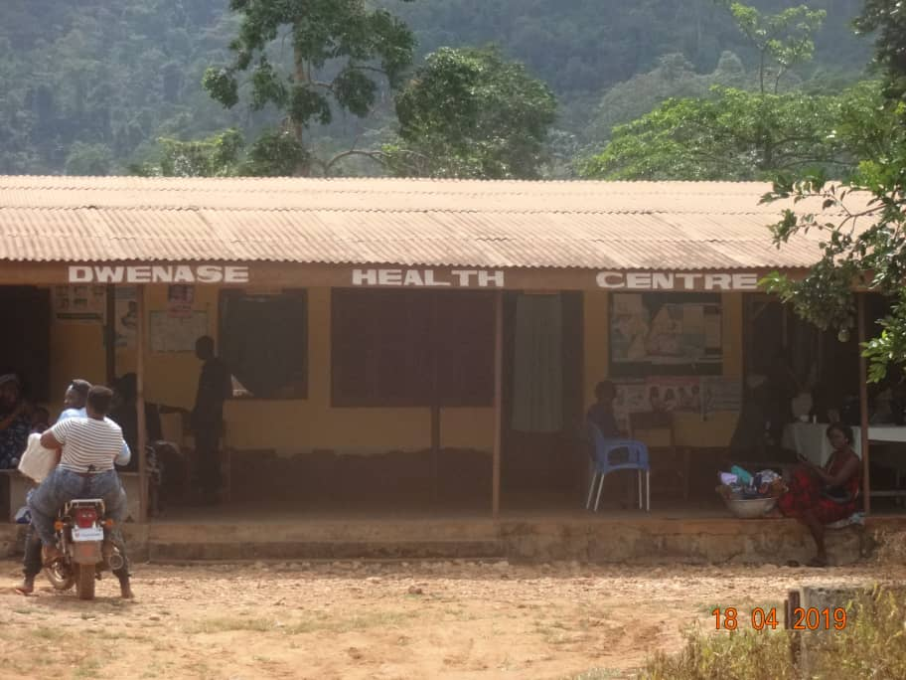
Notes:
Story - Mayah
And today, we’d like to also introduce you to our colleague, Gloria.
Gloria is the director of the Akyem Dwenase Health Centre in the Eastern Region of Ghana. This health centre serves the town’s 3000 residents and all of the communities within a ten kilometer radius.
She knows that patients often travel to her from over an hour away, relying on car, bus, or even foot. They are often delayed by the rough terrain and unreliable transport.
She worries that mothers won’t arrive in time to safely deliver their babies.
The maternity ward is the size of a small office, and today, all three beds are full.
A laboring mother arrives, and Gloria has to move one of the mothers and her newborn to the floor.
This mother has a complicated pregnancy, Gloria has to send her to the District Hospital, another hour away.
She wishes she could safely attend to her at the health center,
Gloria knows that with the right equipment and training, the Akyem Dwenase Health Center could provide more mothers with quality care.
These challenges emphasize two of the most common delays toward accessing maternal and neonatal health care: delays in reaching the health facility and delays in receiving adequate care.
Our Arrive and Thrive! Program seeks to work with the Akyem Dwenase Health Centre to mitigate these challenges by improving emergency planning and transportation, clinical staff training, and the infrastructure, equipment and supplies of the health centre.
Map: In the Eastern Region of Ghana, the Ministry of Health is based in the regional capital of Koforudia, which is approximately two hours away from the Denkyembour District where Akyem Dwenase is located

Slide 3
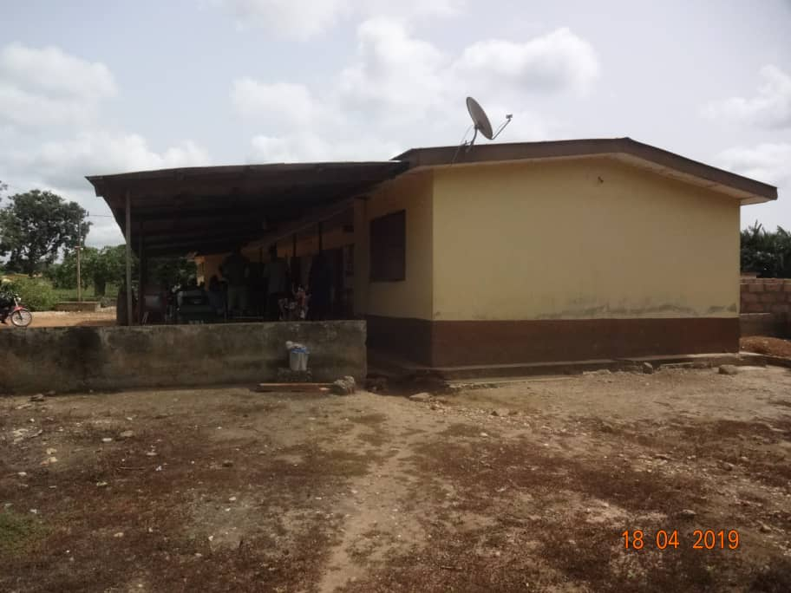
Notes:
Story - Mayah
And today, we’d like to also introduce you to our colleague, Gloria.
Gloria is the director of the Akyem Dwenase Health Centre in the Eastern Region of Ghana. This health centre serves the town’s 3000 residents and all of the communities within a ten kilometer radius.
She knows that patients often travel to her from over an hour away, relying on car, bus, or even foot. They are often delayed by the rough terrain and unreliable transport.
She worries that mothers won’t arrive in time to safely deliver their babies.
The maternity ward is the size of a small office, and today, all three beds are full.
A laboring mother arrives, and Gloria has to move one of the mothers and her newborn to the floor.
This mother has a complicated pregnancy, Gloria has to send her to the District Hospital, another hour away.
She wishes she could safely attend to her at the health center,
Gloria knows that with the right equipment and training, the Akyem Dwenase Health Center could provide more mothers with quality care.
These challenges emphasize two of the most common delays toward accessing maternal and neonatal health care: delays in reaching the health facility and delays in receiving adequate care.
Our Arrive and Thrive! Program seeks to work with the Akyem Dwenase Health Centre to mitigate these challenges by improving emergency planning and transportation, clinical staff training, and the infrastructure, equipment and supplies of the health centre.
Map: In the Eastern Region of Ghana, the Ministry of Health is based in the regional capital of Koforudia, which is approximately two hours away from the Denkyembour District where Akyem Dwenase is located

Slide 4
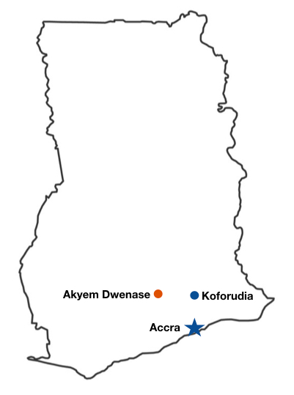
Notes:
Story - Mayah
And today, we’d like to also introduce you to our colleague, Gloria.
Gloria is the director of the Akyem Dwenase Health Centre in the Eastern Region of Ghana. This health centre serves the town’s 3000 residents and all of the communities within a ten kilometer radius.
She knows that patients often travel to her from over an hour away, relying on car, bus, or even foot. They are often delayed by the rough terrain and unreliable transport.
She worries that mothers won’t arrive in time to safely deliver their babies.
The maternity ward is the size of a small office, and today, all three beds are full.
A laboring mother arrives, and Gloria has to move one of the mothers and her newborn to the floor.
This mother has a complicated pregnancy, Gloria has to send her to the District Hospital, another hour away.
She wishes she could safely attend to her at the health center,
Gloria knows that with the right equipment and training, the Akyem Dwenase Health Center could provide more mothers with quality care.
These challenges emphasize two of the most common delays toward accessing maternal and neonatal health care: delays in reaching the health facility and delays in receiving adequate care.
Our Arrive and Thrive! Program seeks to work with the Akyem Dwenase Health Centre to mitigate these challenges by improving emergency planning and transportation, clinical staff training, and the infrastructure, equipment and supplies of the health centre.
Map: In the Eastern Region of Ghana, the Ministry of Health is based in the regional capital of Koforudia, which is approximately two hours away from the Denkyembour District where Akyem Dwenase is located

Slide 5
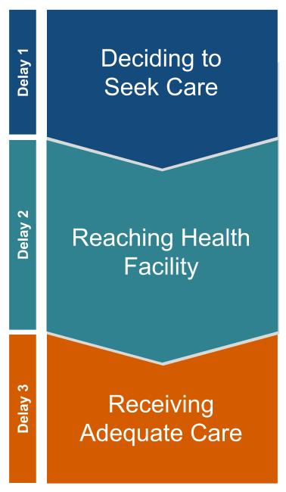
Situation Analysis
310
maternal deaths
per 100,000 live births in Ghana
28
neonatal deaths
per 1,000 live births in Eastern Region
Notes:
To contextualize maternal and neonatal health in Akeym Dwenase, we look to Ghana overall, which has a maternal mortality rate of 310 deaths per 100,000 live births. Most of these deaths are related to hemorrhage, hypertensive disorders, infections, and obstructed labor.
This is lower than most countries in sub-Saharan Africa but is still significantly higher than many countries around the world. For example, in the United States, the maternal mortality is 26 deaths per 100,000 live births. The average for high-income countries is 12 deaths per 100,000.
In the Eastern Region of Ghana specifically, the neonatal mortality rate is 28 deaths per 1,000 live births.
The main reasons for these mortality rates are that women often encounter delays in accessing health care. There are three common delays. Most women in Akeym Dwenase are deciding to seek care, the first potential delay. However, they encounter delays in reaching health facility, the second delay, and with receiving adequate and appropriate care at the facility due to a lack of tracking and equipment on handling complications, the third delay.

Slide 6
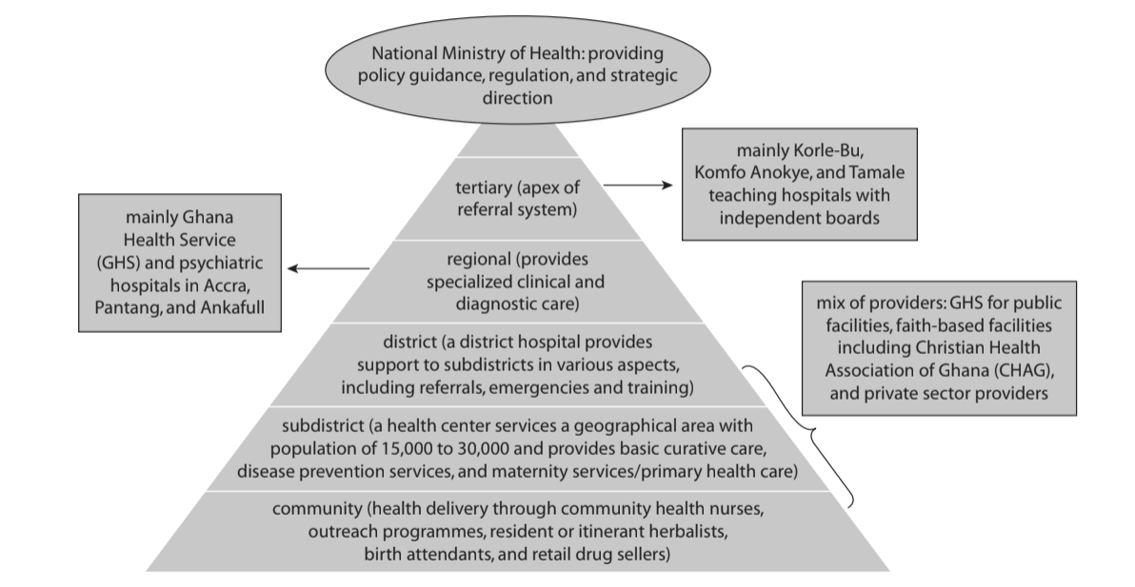
Notes:
The Ghanaian health system has a universal health care insurance system, which covers antenatal care and care related to pregnancy. However, most women report having to pay some fees. The Ghanaian Health system is regulated by the Ministry of Health with tertiary, district, and commuity clinics.
The nearest District Hospital is one hour away. It has 320-beds and offers comprehensive emergency obstetric care.

Slide 7
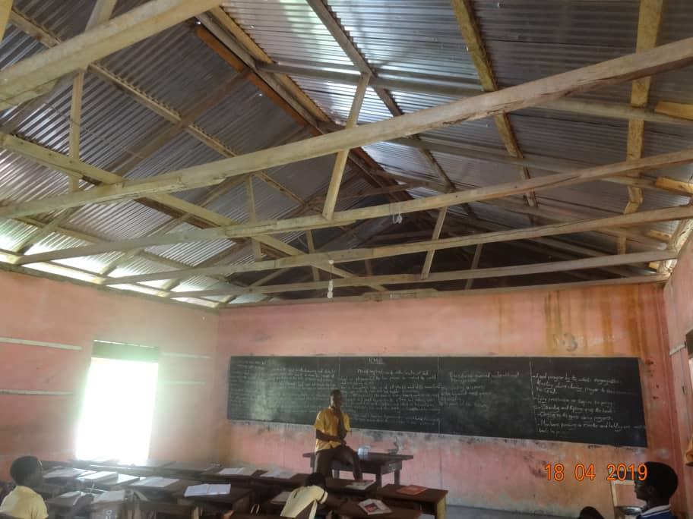
Notes:
Maternal mortality is worse in rural areas like Dwenase.
One of the reasons is delays. Another are social determinants of health including education and wealth. Education can affect whether and when you seek care. SES can affect education and ability to pay costs related to care, transport, and medicines can pose barriers to care.
In Ayem Dwenase, the primary source of employment is farming and mining. Illegal mining is common among youth with limited educational opportunity.
There is a primary and junior high school in the town, but very few students pass the standardized exams to enter secondary school.

Slide 8
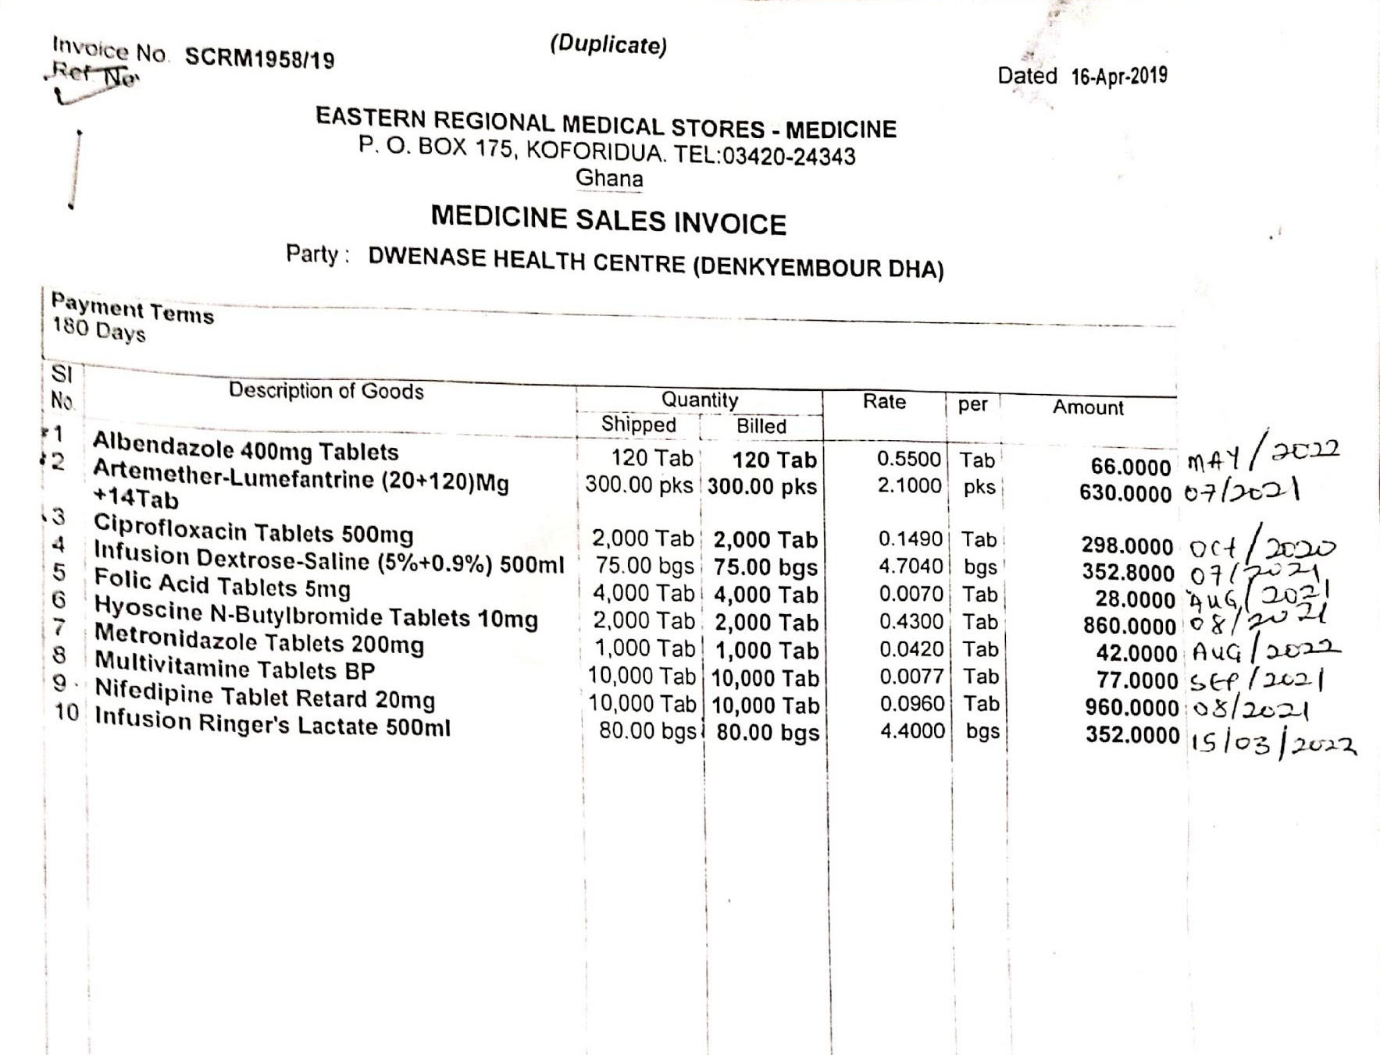
We consider the local stakeholders to be the experts.
Notes:
The challenges faced by the Akyem Dwenase Health Centre in 2019 have been shaped by the colonial and post-colonial history of Ghana.
Ghana became an independent nation in 1956 after more than a century of forced occupation by Britain. During this time, Britain and the United States built their present-day economic power using natural resources and labor from Ghana.
Kwame Nkrumah, the first president of Ghana, coined the term neo-colonialism to describe efforts by the United States and Britain to continue undermining the sovereignty of African communities and governments through aid, trade, and investment
As we undertake this work, we must be cognizant of this history and work to amplify the voices of our local partners. We consider the local stakeholders in this program to be the experts.
Thus, our mission as consultants was foremost to listen to the experiences of our colleagues in Ghana, identify their priorities and vision, and communicate these. Our efforts to listen included conversations through WhatsApp calls and messages, a survey, and receiving written responses to questions.
In building our program proposal, we also sought to identify and share evidence-based program activities that have been previously implemented in Ghana and other sub-Saharan African contexts.

Slide 9
Goal
Every woman and child in the greater Akyem Dwenase community will have access to quality obstetric and neonatal health care.
Notes:
Overall Goal (Dorian)
Through our conversations with centre staff we identified a shared vision for our Arrive and Thrive! program

Slide 10
Objectives
Objective 1: Emergency Preparation & Transportation
Objective 2: Standard Operating Procedures & Training
Objective 3: Equipment, Supplies & Infrastructure
Notes:
Objectives - Dorian
The program focuses on achieving this goal through the objectives based on the two delays most affecting the community - accessing quality care and receiving adequate care
The first objective addresses the delay in reaching the HC by creating a comprehensive emergency preparation and transportation
The second focuses on building the capability for health center staff to handle basic emergency obstetric care through adopting standard operating procedures and conducting staff training and simulations
The last is about meeting the need for more capacity, enhancing the centre’s equipment, ensuring the right amount of supplies and building the infrastructure for an expanded health centre

Slide 11
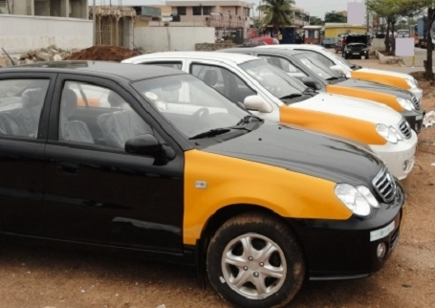
Objective 1
Emergency Preparation & Transportation
RapidSMS Alert System
Emergency Planning
Emergency Transport Network
Notes:
Objective #1 (Dorian)
Note* building upon existing transport system at the health center for on-call system and emergency network
Could add phases of work - piloting and adapting

Slide 12
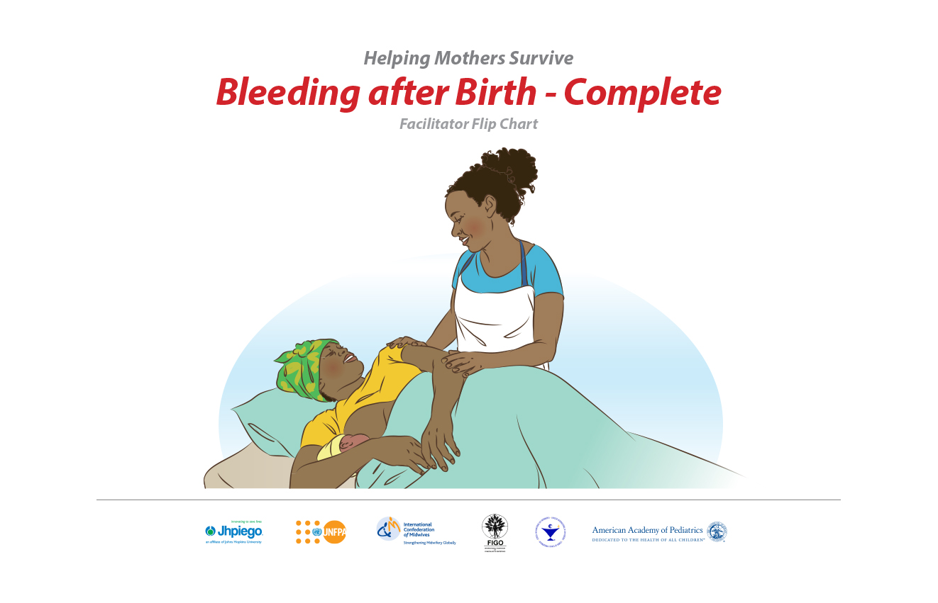
Objective 2
Standard Operating Procedures & Training
Standard Operating Procedures
Low-Dose High-Frequency Training
Notes:
By the end of year 2, all clinical staff at the Akyem Dwenase Health Centre will be able to provide quality general and emergency obstetric and neonatal care.
Annex F. Low-Dose High-Frequency BeMONC Training Program
Rationale
The Low-Dose High-Frequency (LDHF) Training model is a cost-effective competency based training model that takes place in the implementing health facility -- for our purposes, the Akyem Dwenase Health Centre. This approach will better enhance the Health Centre workforce capacity, sustain knowledge and skills gained through training, and help learners translate lessons into their daily clinical practice. LDHF operates with small quantities of content, frequent repetition, participatory simulation-based practice that keeps providers in their clinical environment while learning. This model has been successfully implemented in Mozambique, Uganda, Ghana, Rwanda, Ethiopia, Zambia and has also been applied to programs in the United States.
To implement this training model in Akyem Dwenase, we envision that the training program will consist of 3 Phases:
Phase 1: Development
Referencing the LDHF training program recently implemented in Ghana, Director of the Akyem Dwenase Health Centre (who are employed by the Ministry of Health) will plan the LDHF training program with the Ghana Health Service so as to not overlap with existing training programs. Two existing Ghanaian LDHF Trainers will adapt the curriculum to the Akyem Dwenase Health Centre context.
Phase 2: Startup
The Director of the Health Centre and the Arrive & Thrive! Program Director will work with the LDHF Trainers to schedule and plan BEmONC trainings to occur onsite at the Akyem Dwenase Health Centre. The Arrive & Thrive! Program Director and the LDHF Trainer will identify existing MoH staff in other areas of Ghana who have successfully participated in LDHF training programs to act as mentors for the Akyem Dwenase trainees.
Phase 3: Implementation
Two, 4-day low-dose trainings on basic-emergency obstetric and neonatal care (BEmONC) will be provided at the Akyem Dwenase Health Centre using clinical simulation-based practice with models, mentorship, and coaching, and a daily lunch. Trainees in the program include the Health Centre clinical staff and Community Health Workers who provide labor, delivery, and immediate postpartum care. The first training session (LDHF1) will take place in Month 1 of Year 1, and will focus on basic maternal and neonatal care. The second training (LDHF2) will take place one month after LDHF1 and will cover emergency and delivery complications for maternal and neonatal care. Following these training sessions, content is reinforced through high-frequency mentorship including individual phone calls and text messages between trainees and existing MoH mentors. The Arrive & Thrive! Program will provide financial support for mentorship calls and messages, and a small stipend for mentors to ensure that the mentorship activities are completed. Lodging and food will also be provided for Trainers during the 4 day training periods, as well as meals.
Monitoring
The Director of the Health Centre will report to the Arrive & Thrive Program Director that Health Centre staff are continuing to practice what they have learned, and that trainees are receiving mentorship calls.

Slide 13
Objective 3
Infrastructure, Equipment & Supplies
Equipment
Medical Supplies
Infrastructure
Notes:
Objective #3 (Mayah)
Our 3rd objective is that by the end of year 3, the Akyem Dwenase health centre will be equipped to provide the 7 signal functions of a basic emergency obstetric care facility.
This includes putting systems in place to ensure the health centre has the necessary equipment and medical supplies to provide basic emergency care and involves expanding the maternity ward of the health centre.
Equipment: The Akyem Dwenase Health Centre currently lacks basic supplies to provide quality basic obstetric and neonatal care, including multiple delivery beds, fetal doppler ultrasounds and heart rate monitors. We propose that Health Centre staff assess the current supply of equipment at the Health Centre, and identify what equipment is lacking but needed for general and emergency obstetric and neonatal care. We then propose that funding be allocated to the purchasing of necessary equipment. .
Medical supplies: Another major burden for the Akyem Dwenase Health Centre is a lack of consistent medical supplies, including medicines. This is due both to financial need and supply chain issues. The Health Centre clinical staff can collaborate with the Ministry of Health and the Arrive & Thrive! Program Director to identify supply chain issues and identify alternative means of obtaining the necessary medical supplies in case of shortages or delays in retrievement. The Health Centre staff will develop a checklist of necessary supplies and a system to ensure that these supplies are consistently in stock.
Infrastructure: To ensure that the Health Centre is able to provide the highest attainable quality of care to the mothers and children of Akyem Dwenase, the maternity ward must be expanded and improved to ensure privacy and capacity for a greater number of patients. Through the work of a local architect and collaboration with the community and Health Centre staff, an expanded maternity ward can be designed. The architect can then work with volunteers from the greater Akyem Dwenase community to build the new maternity ward of the Health Centre.
ende d here13.5 minutes

Slide 14
Timeline
Year 1
Year 2
Year 3
Objective 1: Emergency Preparation & Transportation
Objective 2: SOPs and Training
Objective 3: Infrastructure, Equipment & Supplies
Development
Implementation
Planning/SOPs
Implementation
Development
Implementation

Slide 15
Monitoring and Evaluation
Monitoring: Was the Arrive & Thrive! Program implemented as outlined in the work plan?
Evaluation: Did implementation of the Arrive & Thrive! Program improve access to quality BEmONC for the women and children in the greater Akyem Dwenase area?
Data Collection, Analysis, and Dissemination
Notes:
Mixed methods approach to M&E
Monitoring: Is the program taking place as planned?
qualitative methods will include: patient surveys, focus groups
Quantitative: SMS usage reports, patient and provider activity tracking, tracking document development (i.e. checklists, plans, etc.)
If the M&E team find that the program is not being implemented according to plan, we have included space for the A&T! Program Director to collaborate with Health Centre Staff to reevaluate priorities and proceed accordingly.
Eval: measuring improved access to quality care through evaluating patient experience and quality of care
Baseline
Midline (1.5 years)
Endline
Qualitative: patient surveys regarding transportation services, endline competency evaluations (simulations) of staff and CHWs. Quantitative: Uptake of RapidSMS usage, improved patient outcomes (w regards to complications)
17 min

Slide 16
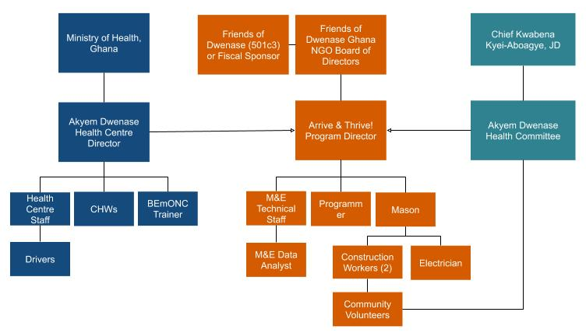
Organizational Structure
Notes:
Org chart - mayah
The Arrive & Thrive! Program involves three different entities: the Ministry of Health, the Friends of Dwenase, and Chief Kwabena Kyei-Aboagye. Under the Friends of Dwenase NGO, there is an Arrive & Thrive! Program Director that is responsible for the M&E Technical Staff, the RapidSMS Programmer and the Mason.
The M&E data analyst will report to the M&E technical staff, while the construction workers and electrician will report to the Mason responsible for the expansion of the maternity ward. The community volunteers are also involved in this construction project, and while they will be recruited by the Health Committee, they will primarily work under the direction of the construction workers. Chief Kwabena Kyei-Aboagye oversees the Akyem Dwenase Health Committee, which will help to find, recruit, and maintain community volunteers.
Also integral to the Arrive & Thrive! Program is partnership with the Ghanaian Ministry of Health. The Akyem Dwenase Health Centre Director reports to the MoH and is responsible for managing the Community Health Workers (CHWs) and the Akyem Dwenase Health Centre staff. The Health Centre staff are responsible for the On-Call Drivers that will be a part of the Emergency Transportation Network. The BEmONC trainer will primarily manage their own work and responsibilities; however, it is possible that the MOH will be able to provide additional financial support for this position.

Slide 17
Budget
Type of Expense | Year 1 | Year 2 | Year 3 | Total
Salaries | $7,650.00 | $7,956.00 | $6,002.88 | $21,608.88
Contracted Workers | $2,726.00 | $1,794.00 | $3,363.78 | $7,883.78
Benefits | $994.50 | $1,034.28 | $780.37 | $2,809.15
Travel & Per Diem | $8,510.00 | $9,074.00 | $9,869.60 | $27,453.60
Supplies | $3,350.00 | $7,914.40 | $9,442.37 | $3,350.00
Maternity Ward | $0.00 | $6,835.61 | $8,091.20 | $14,926.81
Total Costs | $23,927.42 | $35,646.54 | $38,676.70 | $98,250.66
Notes:
Dielle
We have a 98,000 budget over three years
These costs are divided between salaries and benefits, contracted workers, travel and per diem, supplies, and the expansion of the maternity ward.
We are happy to discuss our budge more in the Q&A section.

Slide 18
Funding
The program will rely on diverse funding sources.
1
2
3
4
Fundraising
Events
CSR
Partners
Foundations
& Grants
Community
Support
Notes:
Fundraising Events for training and initial investments
Ghana Corporate Social Responsibility Partnerships - advertising on taxis
Foundation and grants for supplies, equipment, building project
Community support for recurring investments

Slide 19
Sustainability
Supply Chain Analysis
Early Implementation of RapidSMS & Transport System
Simulation-based Practice & Participatory Teaching
Equipment Risk Assessment
Friends of Dwenase
Health Committee
Program Director
Notes:
Sustainability - Dorian
Each element of the program is designed for sustainability with many of the costs being one time. The elements of the emergency planning and transport system will all be piloted and implemented during the first year of the program allowing for complete integration
For the capability building portion, the low-dose high-frequency trainings are paced for long-term retention. Additionally, select staff will be tasked with learning and replicating these trainings for new staff, ensuring continuity
As the centre grows the Program Director will work with staff to conduct a medical supply chain analysis to proactively anticipate needs, and as equipment and infrastructure are added to the centre, will analyze lifetime of equipment and create contingency plans.
The program as a whole is supported by strong partners committed to its ongoing success. Friends of Dwenase will manage the overall ongoing funding efforts, in collaboration with strategic guidance from the health committee. The Director will be tasked with ensuring each element of sustainability is implemented.
Script ths out a bit more
Ended on 22:18

Slide 20
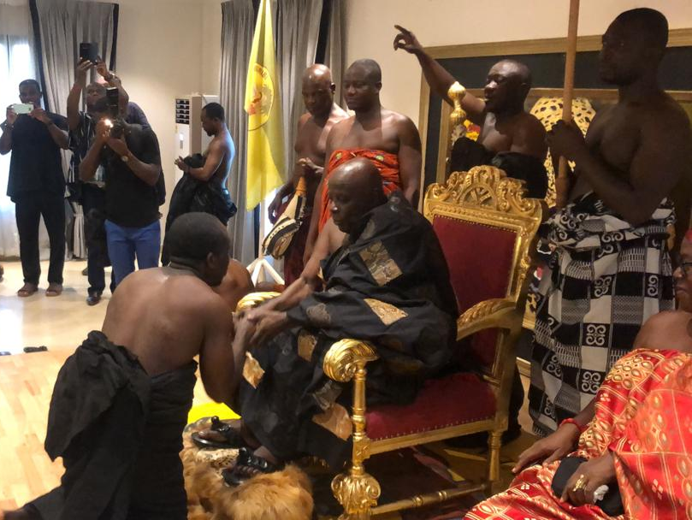
Notes:
Kwabena / Gloria / Call to Action - Mayah
KWABENA: The strongest support for this program comes from the Chief of the village himself, Kwabena Kyei-Aboagye. Not only does he lead the village of Akyem Dwenase, but he earned his Juris Doctor degree at the Suffolk University Law School in Boston, and shares his expertise in city planning and urban affairs as an Adjunct Professor of Urban Planning at Boston University. His new leadership role in the community presents a unique opportunity to address the social and environmental justice issues that he has researched for over twenty years.
GLORIA: Let’s take a moment to revisit Gloria, our colleague at the Akyem Dwenase Health Centre. It’s 3 years later, and the Arrive and Thrive! Program has been implemented and now with a new emergency preparation and transportation system in place, clinical staff training in basic emergency maternal and neonatal care made available on-site, and the necessary medical supplies, equipment and infrastructure in place, Gloria is now able to provide quality care to her patients.
Thank you all. We welcome any questions you may have.

Slide 21
Thank You! Questions?

