Slide 1
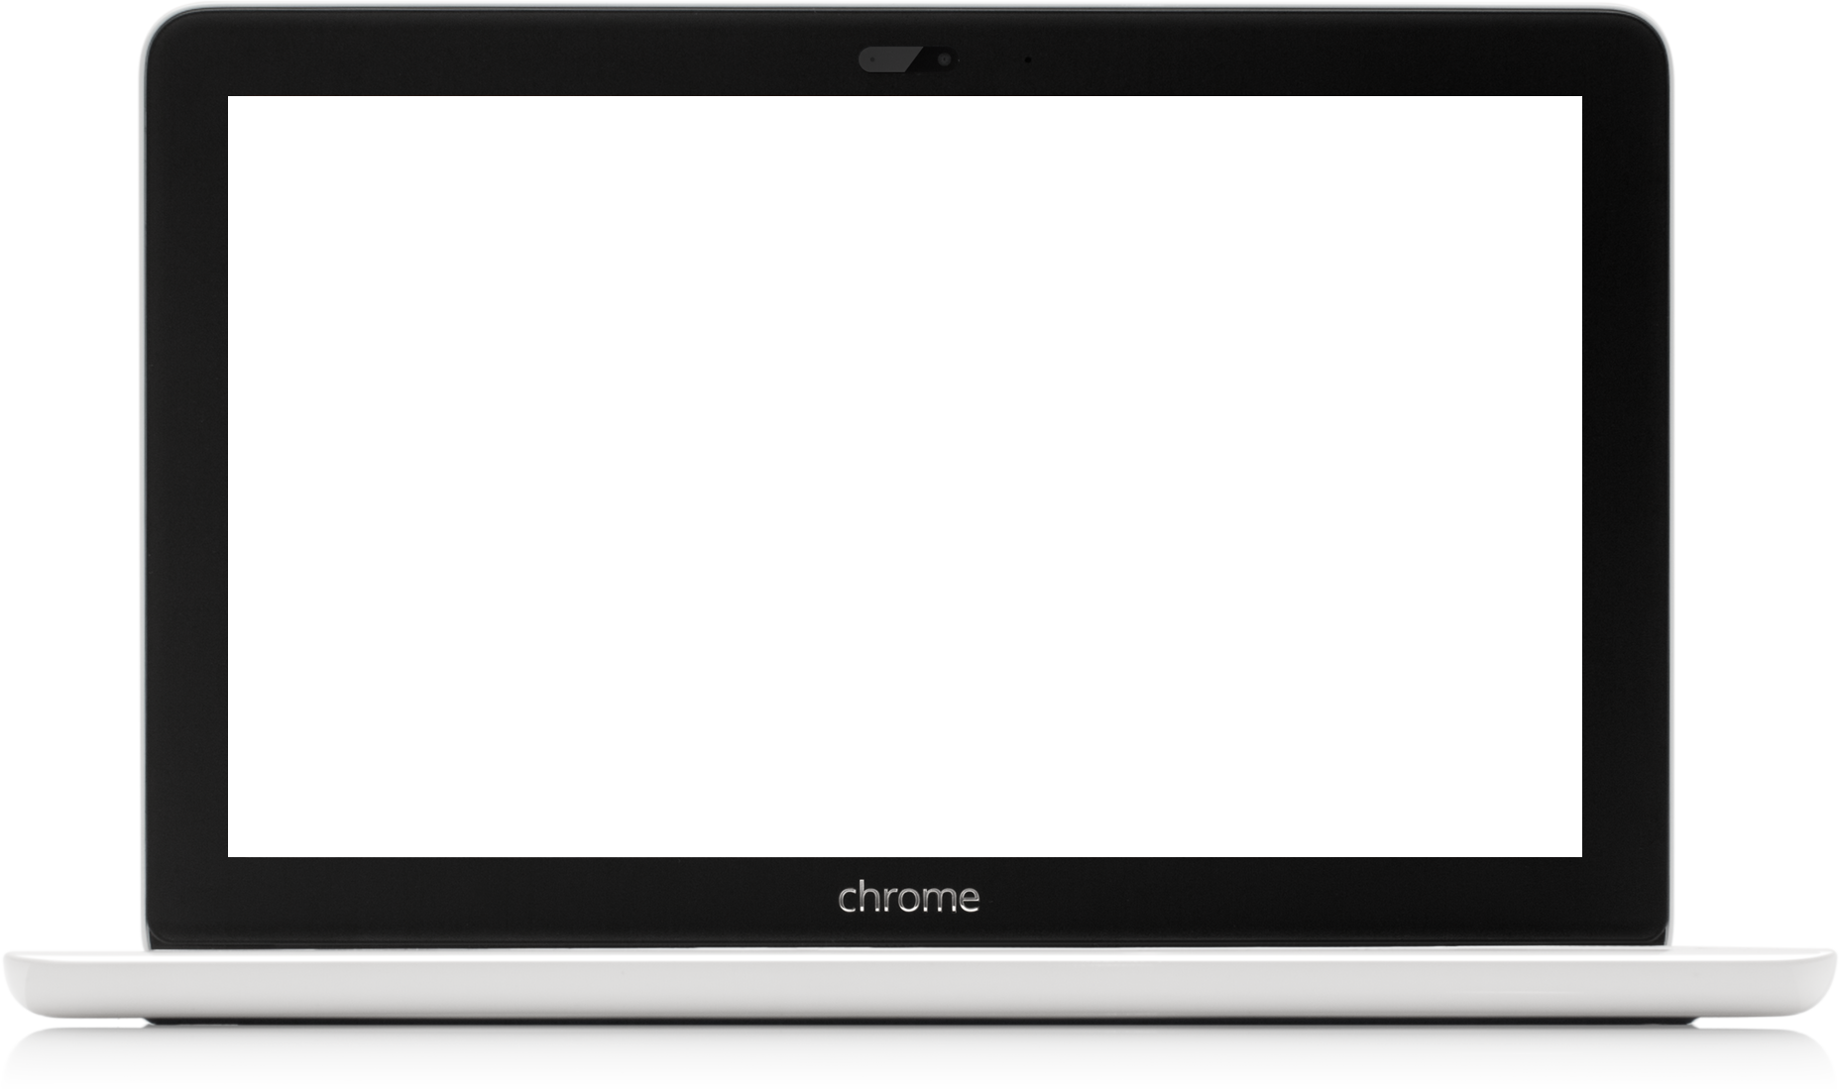
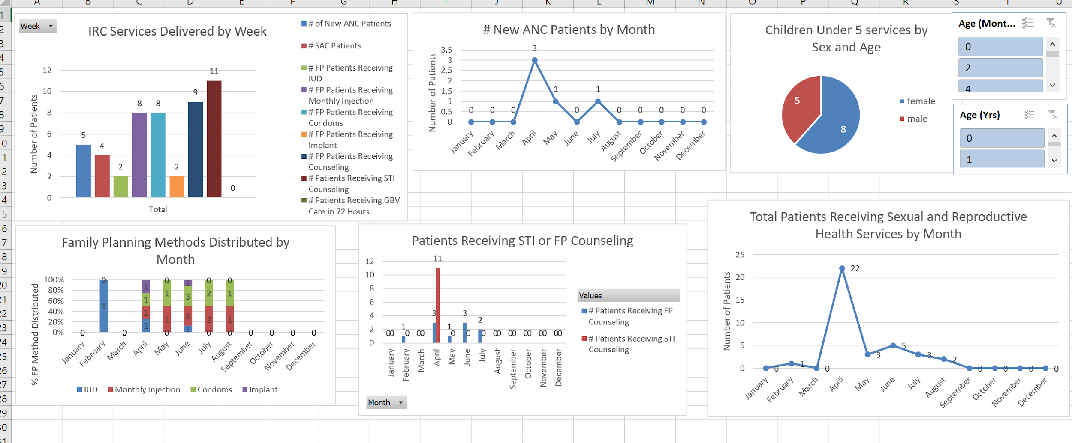
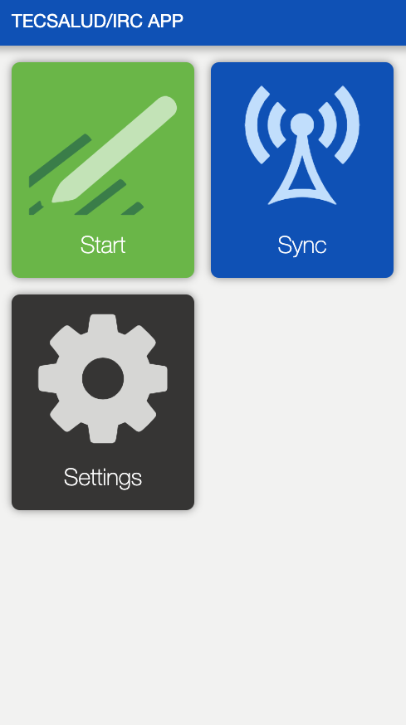
Improving Health Service Delivery to Venezuelan Refugees
TecSalud & IRC Colombia
Candice Bangham, Iván Montoya, Greg Kantor, Meagan Elam
Notes:
You will have a total of twenty minutes, ten minutes for the presentation and ten minutes for Q&A. The presentation should cover the background gap analysis, the intervention, mock data collected, a plan for monitoring and evaluating the intervention and a plan for scale up and sustainability. Please prepare any materials that you would like to share as part of the presentation.
The presentations should cover the:
● Background/Problem
● Use Case/Solution
● App Functionality Overview - is this the same as workflows? Video of your screen going through the app with voice narrative
● Monitoring and Evaluation
● Scaling/Sustainability
Additionally, it is helpful to prepare a one page brief for members of the audience describing your project and what will be covered during the presentation.
10 minutes to present/5 minutes Q&A

Slide 2
Needs Assessment
Notes:
References:
https://www.unhcr.org/venezuela-emergency.html
https://s3.amazonaws.com/unhcrsharedmedia/2018/RMRP_Venezuela_2019_OnlineVersion.pdf
https://www.unhcr.org/news/press/2018/11/5be4192b4/number-refugees-migrants-venezuela-reaches-3-million.html
Background:
Venezuela is in a deep economic and political crisis, which has caused a mass influx of refugees fleeing into Colombia (>1 million, ~37,00 crossing into Colombia per day). The regional IRC is working in Cúcuta, a border city, providing assistance to Venezuelan refugees seeking asylum and fleeing into Colombia.
Use Case: The IRC Colombia team currently collects their family planning and patient data on paper and Excel. Collaborating with TecSalud, our team will develop an app that will help IRC workers in Cúcuta collect faster and more accurate data and patient case management.

Slide 3
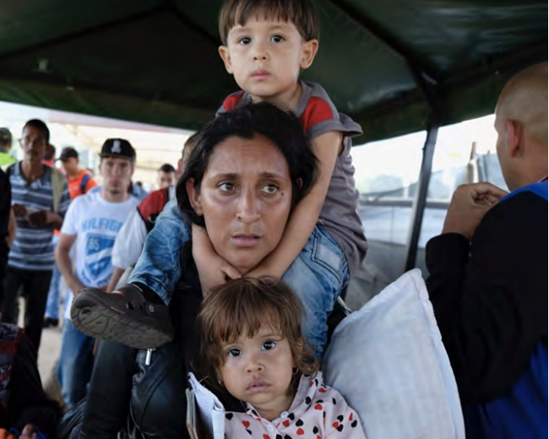
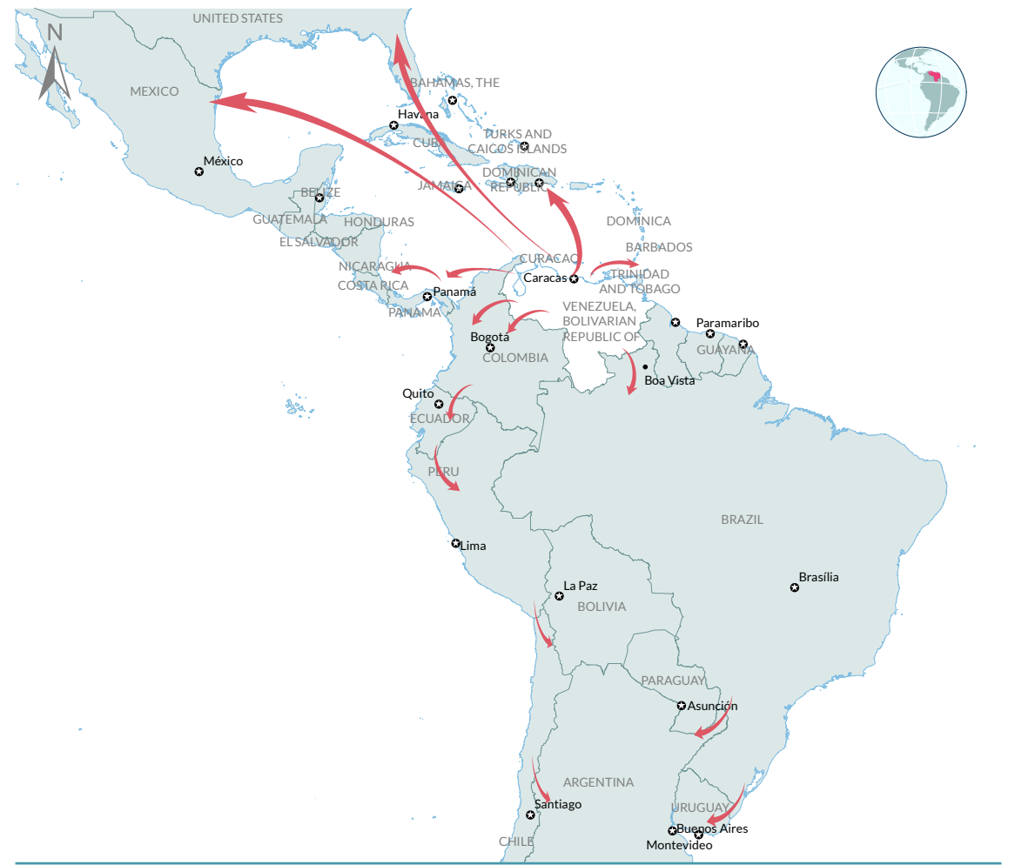
Since 2014, over 3 million refugees have left Venezuela due to ongoing political and economic crises
Deep economic and political crises marked by scarcity of basic goods and medicine created an exodus of Venezuelans fleeing to neighboring countries and beyond.
Venezuelans lack guaranteed access to basic rights due to lack of legal documentation, and permission to stay in neighboring countries.
Colombia has received >1 million refugees and migrants from Venezuela, with ~37,000 crossing into Colombia per day.
Source: https://s3.amazonaws.com/unhcrsharedmedia/2018/RMRP_Venezuela_2019_OnlineVersion.pdf
Notes:
References:
https://www.unhcr.org/venezuela-emergency.html
https://s3.amazonaws.com/unhcrsharedmedia/2018/RMRP_Venezuela_2019_OnlineVersion.pdf
https://www.unhcr.org/news/press/2018/11/5be4192b4/number-refugees-migrants-venezuela-reaches-3-million.html
Background:
Venezuela is in a deep economic and political crisis, which has caused a mass influx of refugees fleeing into Colombia (>1 million, ~37,00 crossing into Colombia per day). The regional IRC is working in Cúcuta, a border city, providing assistance to Venezuelan refugees seeking asylum and fleeing into Colombia.
Use Case: The IRC Colombia team currently collects their family planning and patient data on paper and Excel. Collaborating with TecSalud, our team will develop an app that will help IRC workers in Cúcuta collect faster and more accurate data and patient case management.

Slide 4
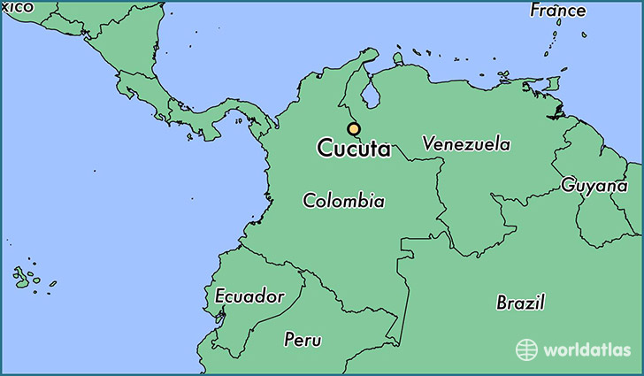
IRC’s health workers need a digital solution to improve data quality and case management
International Rescue Committee (IRC) Colombia provides reproductive and sexual health services, maternal health services, and referrals to primary care services for children under 5.
Use Case: Clinicians and health workers providing care to refugees in IRC health clinics in Cúcuta, Colombia
Collaborating with TecSalúd, our team developed an app to help IRC workers in Cúcuta update their previous data collection methods: paper and Excel
Working in Cúcuta, the principal crossing site on the Colombia-Venezuela border.
Source: https://www.worldatlas.com/sa/co/nsa/where-is-cucuta.html
Notes:
References:
https://www.unhcr.org/venezuela-emergency.html
https://s3.amazonaws.com/unhcrsharedmedia/2018/RMRP_Venezuela_2019_OnlineVersion.pdf
https://www.unhcr.org/news/press/2018/11/5be4192b4/number-refugees-migrants-venezuela-reaches-3-million.html
Background:
Venezuela is in a deep economic and political crisis, which has caused a mass influx of refugees fleeing into Colombia (>1 million, ~37,00 crossing into Colombia per day). The regional IRC is working in Cúcuta, a border city, providing assistance to Venezuelan refugees seeking asylum and fleeing into Colombia.
Use Case: The IRC Colombia team currently collects their family planning and patient data on paper and Excel. Collaborating with TecSalud, our team will develop an app that will help IRC workers in Cúcuta collect faster and more accurate data and patient case management.
ollaborating with TecSalúd, our team will develop an app that will help IRC workers collect data faster and more accurately and better manage continuous patient care, replacing their previous data collection methods: paper and Excel.

Slide 5
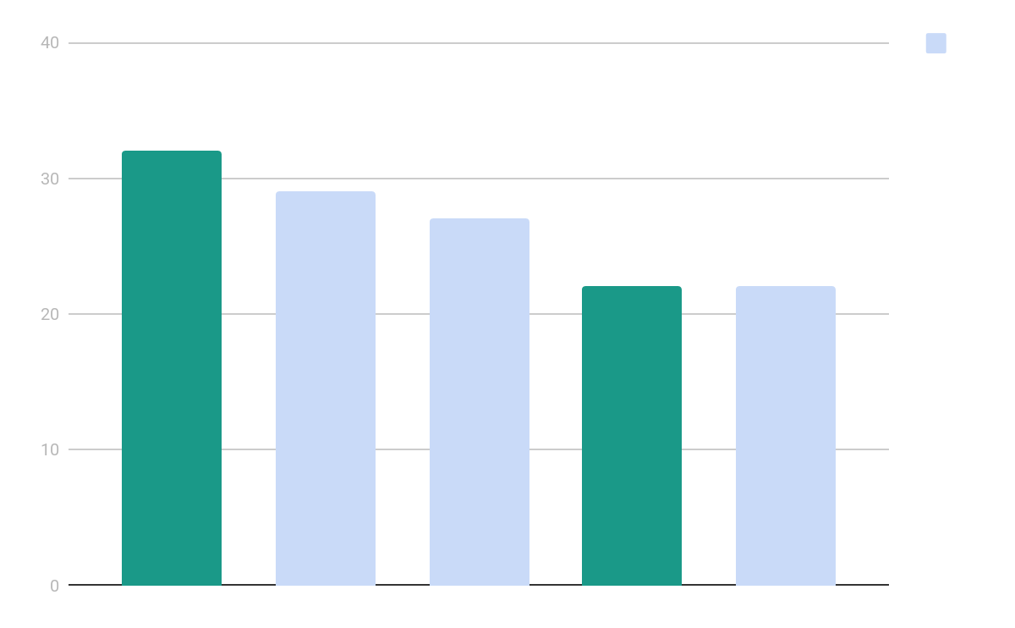
Evidence suggests that mHealth interventions in maternal health and family planning improve outcomes and are cost effective
Senegal - midwives spent less time collecting data and more time supporting households and women ²
India – ReMIND (Reducing Maternal and Infant Deaths) project
Nearly 3/4 of women received FHW counseling guided by mHealth application, a 28% improvement ³
ReMIND reduced maternal deaths by 0.2% and infant deaths by 5.3% ⁴
Estimated savings of $425M USD by increasing preventive services ⁴
Maternal health
Infectious disease
Child health
Family planning
Other
In a recent assessment of 133 international mHealth applications designed for frontline health workers, 41% were designed for either maternal health or family planning ¹
Notes:
References:
http://media.wix.com/ugd/f85b85_cc8c132e31014d91b108f8dba524fb86.pdf
https://resource-allocation.biomedcentral.com/articles/10.1186/s12962-018-0110-2
https://www.crs.org/sites/default/files/tools-research/a4_case_study_remind_final_online.pdf
https://resource-allocation.biomedcentral.com/articles/10.1186/s12962-018-0110-2

Slide 6
Colombia’s mobile technology infrastructure
Source: GSMA Country Overview: Colombia, 2017
Notes:
Talking Points:
Colombia has a strong mobile technology infrastructure for use of digital interventions to improve health service delivery, especially in urban areas
96% of all towns and villages with more than 100 inhabitants now have 3G or 4G connectivity.
Cúcuta, capital city of the Norte de Santander region, is served by Telecom Colombia and has 14 free wifi zones throughout the city to facilitate use of mobile health interventions.
http://www.cucuta-nortedesantander.gov.co/noticias-735287/administracion-municipal-mantendra-conectividad-de-zonas

Slide 7
Proposed Solution

Slide 8
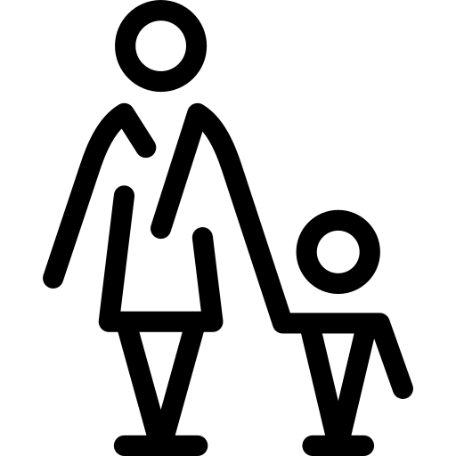
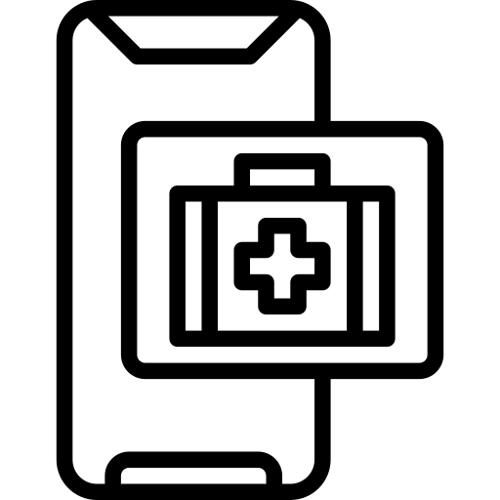
Goals of the Mobile Data Quality (MDQ) App
Improve case management
Improve data collection process (quality + ease)
Improve information available at point of care
Improve M&E capabilities
Notes:
Mobile Data Quality (MDQ) App enables clinicians to collect necessary data for patients and use case management to improve continuity of care.
To improve IRC’s ability to provide continuous quality health services to Venezuelan refugees through improved data collection.
To improve the ease of the documentation process for IRC’s clinicians serving patients in Cúcuta.
To improve clinicians’ ability to reference previously recorded health information at the point of care.
To support IRC’s monitoring and evaluation of their service delivery through an improved dashboard to visualize key metrics.

Slide 9
High Level Process Map
Dashboard allows IRC M&E Officer to quickly see beneficiaries served and services provided
Specialty forms completed during each visit with KVPs
Reporting required for donors and other key stakeholders relies on key metrics collected in dashboard
Notes:
On this high level process map, which you have a copy of in front of you, you will see the process by which physicians will register all patients and track services provided to Key Vulnerable Populations, which populates IRC’s M&E database (reference the call out boxes).

Slide 10
User Flow: Breakdown of forms
Clinician determines if patient is a KVP requiring additional documentation.
Clinicians complete registration form for all patients at first contact.
Notes:
A separate form is used for each line of service provision
7 total forms:
Registration form to be completed for all patients IRC serves (shown in the high level process map)
The children <5 form tracks primary care services and referrals for all beneficiaries < 5 years old
5 forms for specific sexual and reproductive services provided to women of reproductive age
Questions are matched to an M&E metric collected in IRC’s current reporting database.

Slide 11
Stakeholder Collaboration
Role of User | Clinician: Register and enter patient level data IRC M&E: Analyze and report KPIs Health Coordinator: Makes programmatic and funding decisions based on KPIs TecSalúd: Provide technical assistance for MDQ app
Job Function | Clinician: Provide primary care services to KVP IRC M&E: Monitor and Evaluate services provided in IRC clinics Health Coordinator: Manage of Health Programs & Training TecSalúd: Develop and maintain MDQ app & facilitate professional translation
Decisions made by Users | Clinician: Referral and treatment options for continuity of care IRC M&E: What to report to funders and to determine critical gaps that exist and need to be brought to IRC leadership Health Coordinator: Improve training to meet the needs of Venezuelan refugees TecSalúd: QI of MDQ app
Notes:
In order for these processes to be successful, collaboration between multiple stakeholders is key to ensuring that Venezuelan refugees get the quality health services they need
The four key stakeholders for the MDQ App and health service delivery to refugees include IRCs Clinicians (who deliver health services and record data in the app), IRC M&E staff (who analyze and report on KPIs), the Health Coordinator (oversees program efforts), and TecSalud (who provide TA for the app).

Slide 13
Data Dashboard and Monitoring & Evaluation

Slide 14
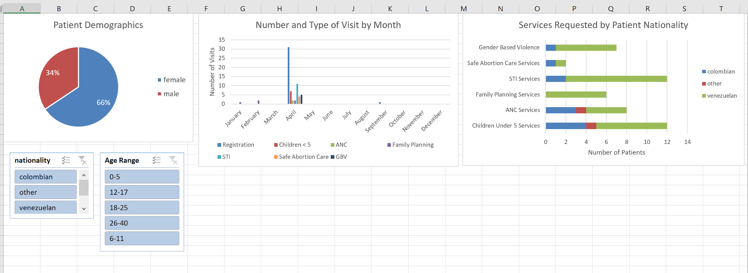
MDQ General Dashboard
Total Patient Breakdown by Gender, Age, and Nationality
Number and Type of Services by Month and by Patient Nationality
Intended Users: IRC Health Coordinators
Notes:
Data from the MDQ App can be exported into a dynamic dashboard that updates automatically and facilitates programmatic decision-making at multiple levels

Slide 15
IRC Key Performance Indicator (KPI) Dashboard
Slicers allow for comprehensive demographic breakdown of KVPs.
Overall performance on donor KPIs can be broken down by individual weeks.
Monthly count of each family planning method distributed in IRC clinic.
Total # of women receiving ANC, Family Planning, STI, or Safe Abortion Services broken down by month.
Intended Users: IRC M&E Officers
Notes:
IRC M&E Officers can use the more detailed dashboard to track progress on organizational and donor key performance indicators (KPIs)

Slide 16
Evaluating the MDQ Application
Element | Indicator
Data Completion | Percentage of IRC Reporting elements populated with data
Data Integrity | Percentage of IRC Reporting elements populated with the intended data
Accessibility | Number of beneficiaries logged by each mobile user Clinician/mobile user satisfaction with application
Notes:
Monitoring and Evaluation of the MDQ App will complement IRC’s existing M&E efforts

Slide 17
Scale Up and Sustainability

Slide 18
Potential for expansion in other settings with humanitarian crises
Opportunities for Scale-Up of MDQ App
Growth and Expansion: Increase base within IRC--Health Programs also present in Medellín, Colombia and Brazil.
Resources Needed: funding, staff, providers, technical assistance (on staff)
Sustainability
Potential Challenge: Free subscription to CommCare supports 10 unique mobile accounts.
Lowest priced subscription is $250 USD/month
Notes:
There is expansion potential for a modified hybrid strategy that uses government and private donor support to provide health services during humanitarian crises in cities and countries where the IRC is present.
Migration of refugees elsewhere within Colombia
An increase in the quality of data collection from scaling up will result in an increase in funding, which will increase treatment ability and quality and an increase in their ability to provide continuity of care.

Slide 19
TecSalud Consulting Team
MDQ Project URL: https://www.commcarehq.org/a/tecsal-d-irc/dashboard/project/

Slide 20
Questions?

Slide 21
References
https://www.unhcr.org/venezuela-emergency.html
https://s3.amazonaws.com/unhcrsharedmedia/2018/RMRP_Venezuela_2019_OnlineVersion.pdf
https://www.unhcr.org/news/press/2018/11/5be4192b4/number-refugees-migrants-venezuela-reaches-3-million.html
http://media.wix.com/ugd/f85b85_cc8c132e31014d91b108f8dba524fb86.pdf
https://resource-allocation.biomedcentral.com/articles/10.1186/s12962-018-0110-2
https://www.crs.org/sites/default/files/tools-research/a4_case_study_remind_final_online.pdf
https://resource-allocation.biomedcentral.com/articles/10.1186/s12962-018-0110-2
http://www.cucuta-nortedesantander.gov.co/noticias-735287/administracion-municipal-mantendra-conectividad-de-zonas

Slide 22
Appendices

Slide 23
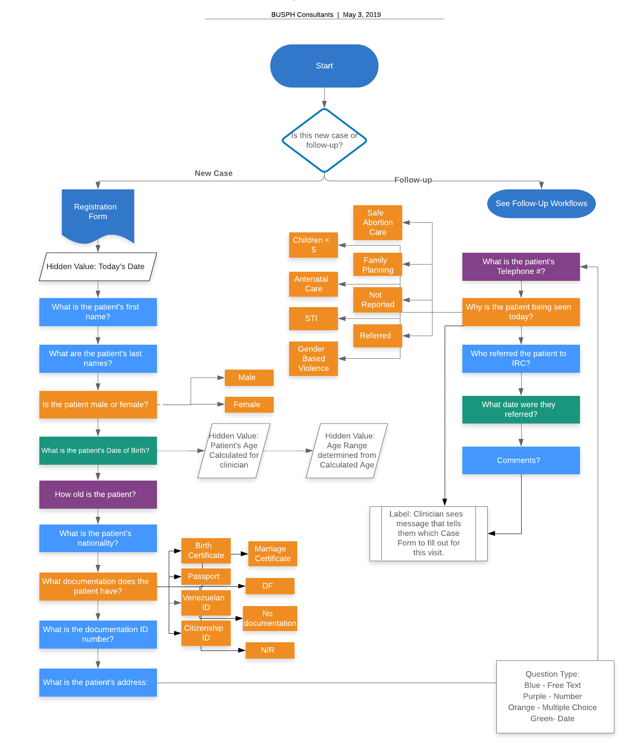
Registration Form

Slide 24
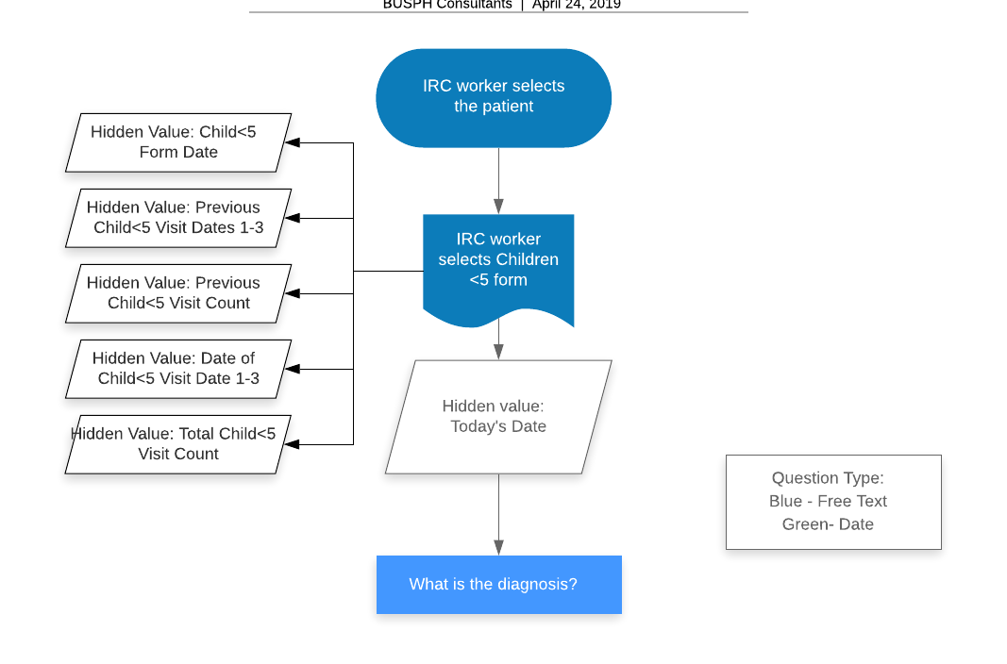
Children < 5

Slide 25
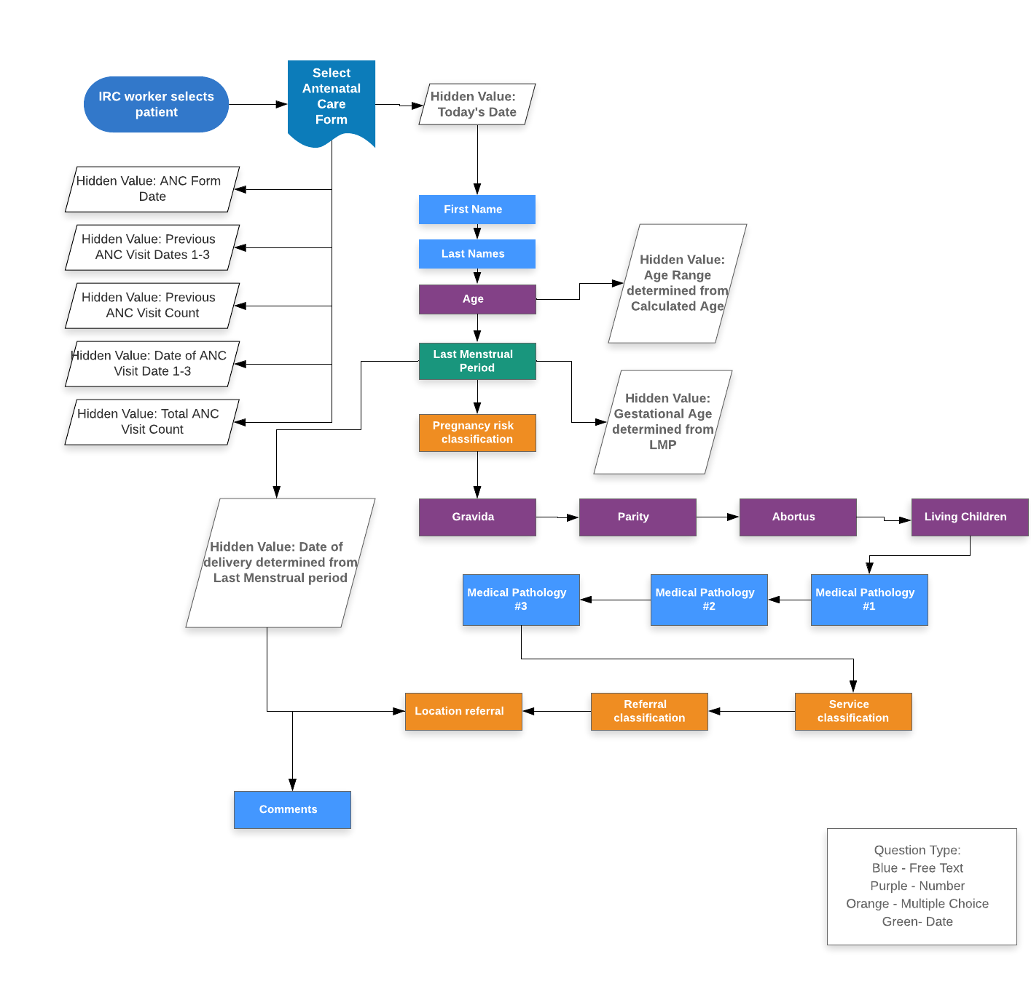
Antenatal Care

Slide 26
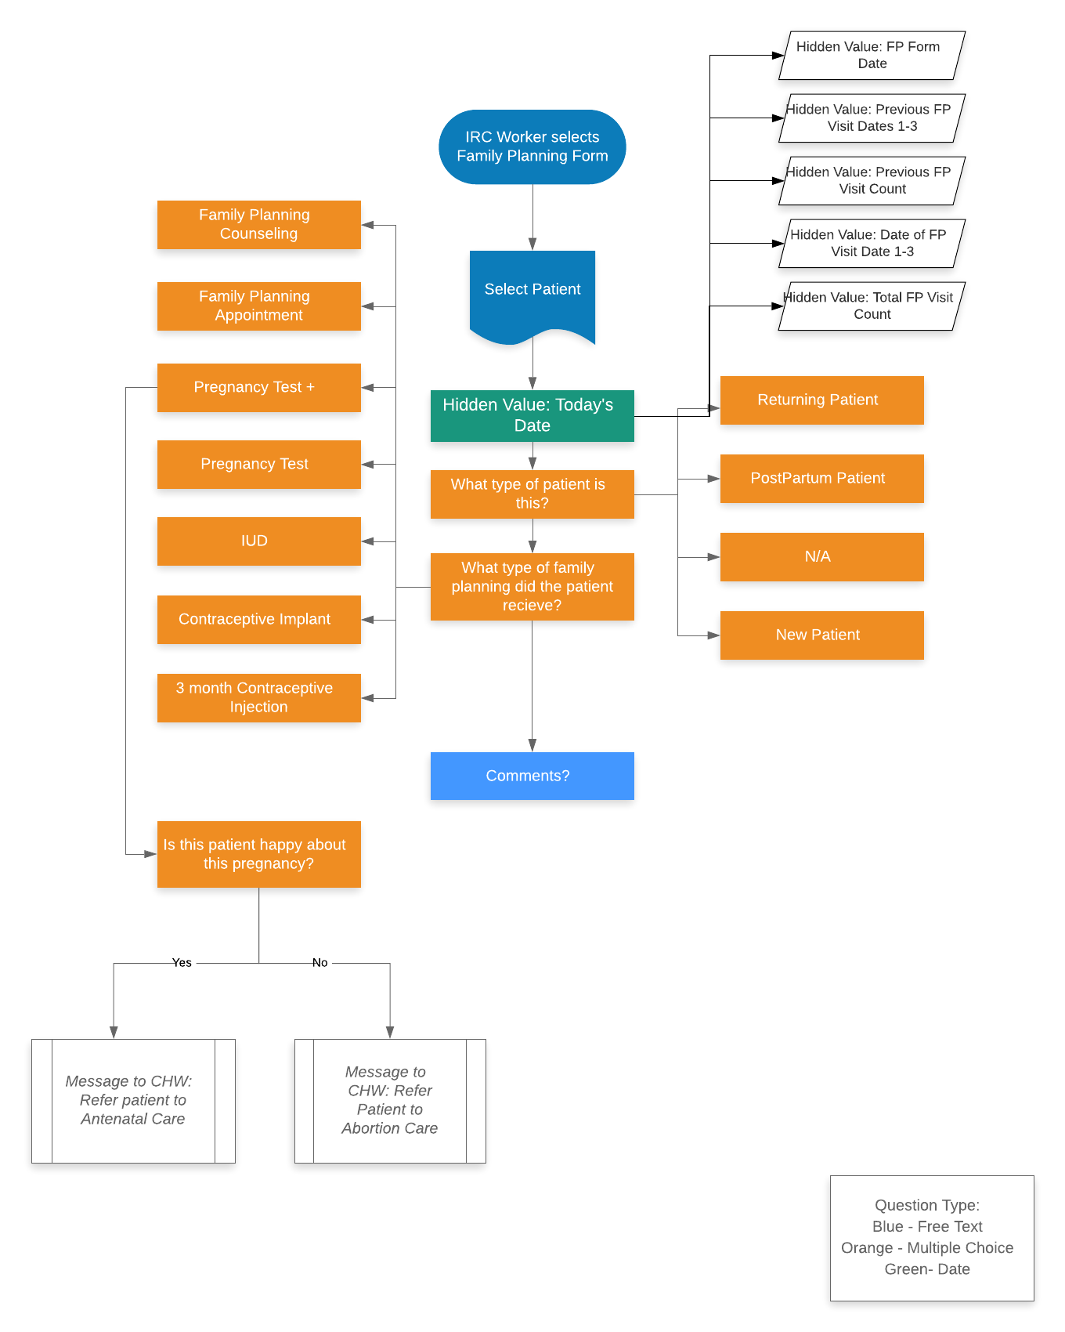
Family Planning

Slide 27
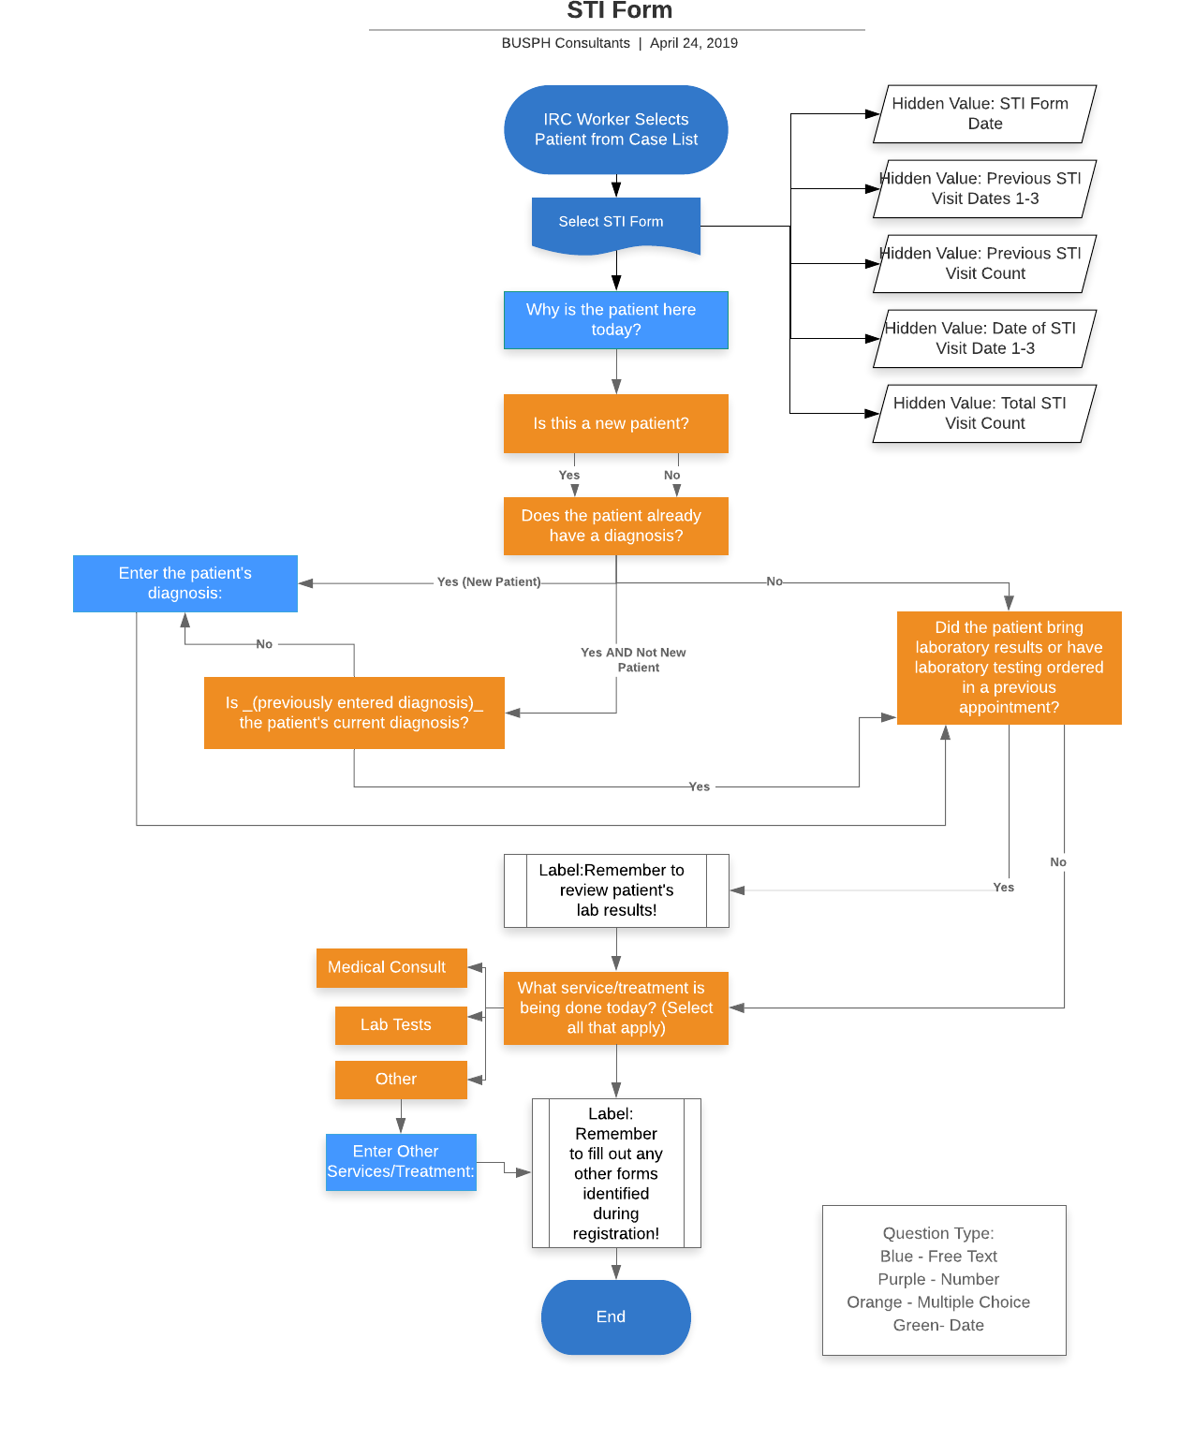
STI Form

Slide 28
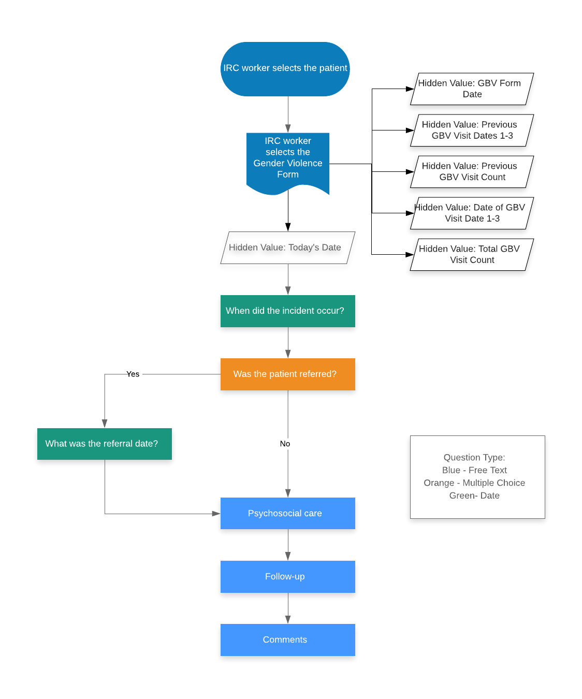
Gender-Based Violence Form

Slide 29
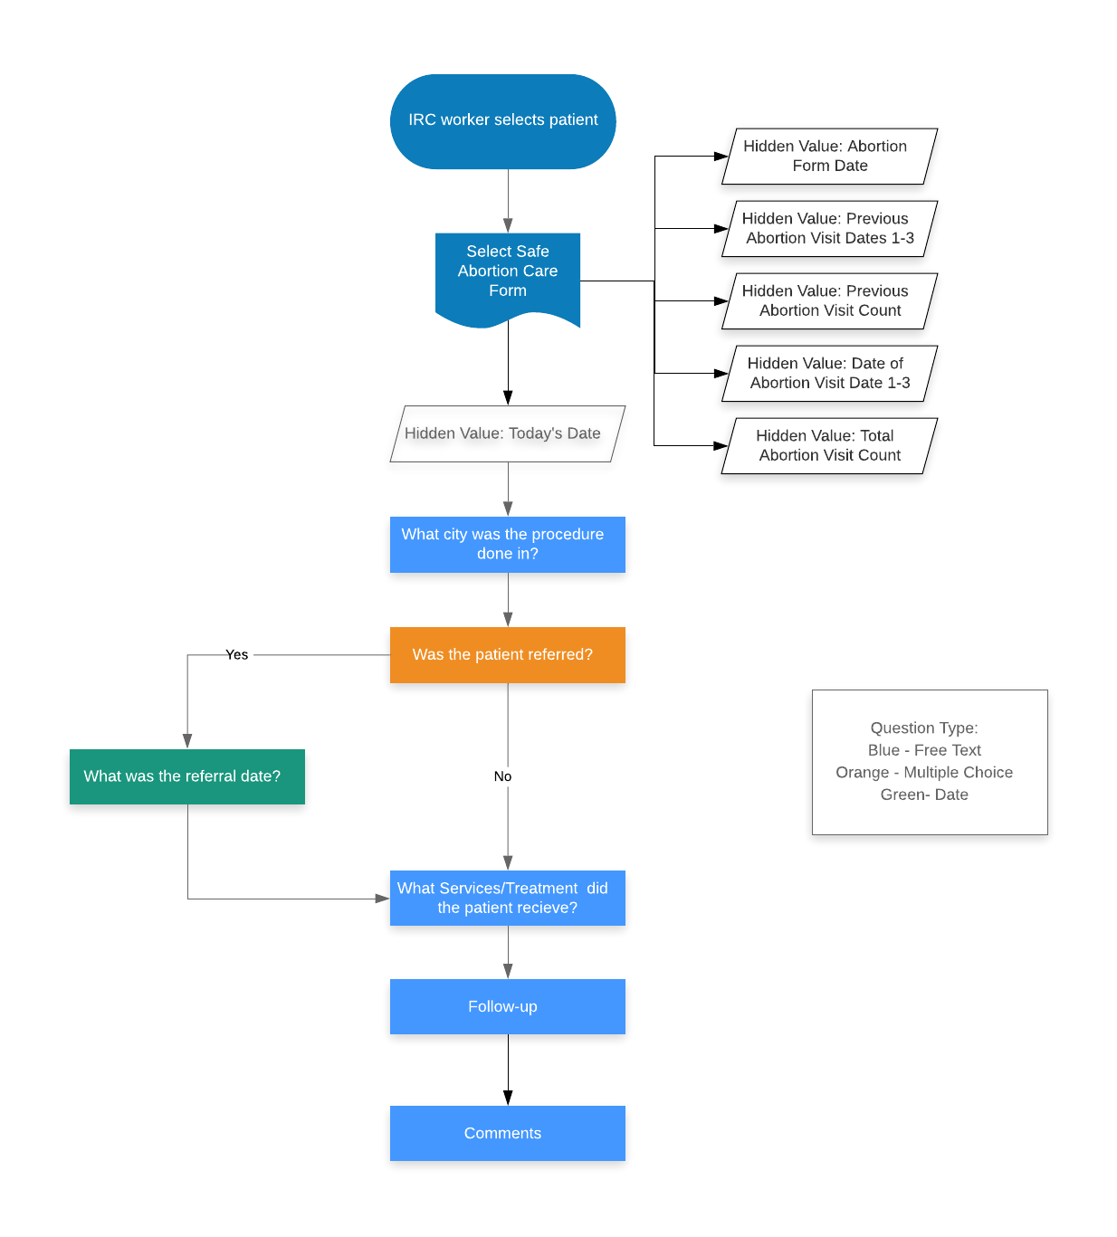
Abortion Care Form

