Slide 1
Rheumatic Heart Disease (RHD) Remote-Entry Data capture (RED) Registry
Baylor-Malawi Children’s Center
Novus Health Consulting Group
Yara Altaher, Maria Campos, Araz Chiloyan, Haley Friedler, Jack Zhu

Slide 2
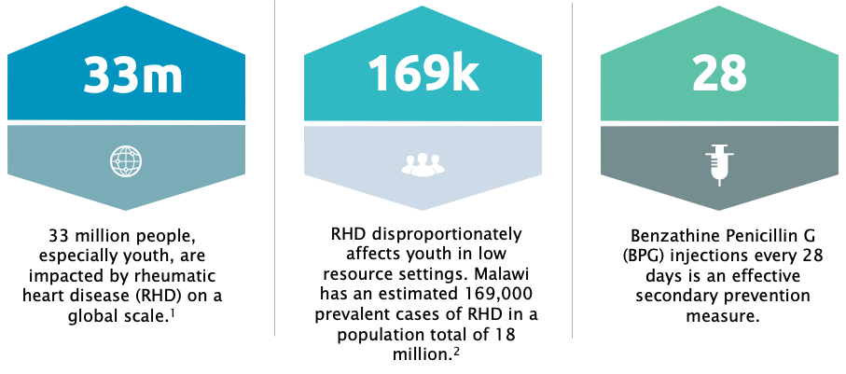
RHD Disproportionately Affects Youth in Low Resource Settings

Slide 3
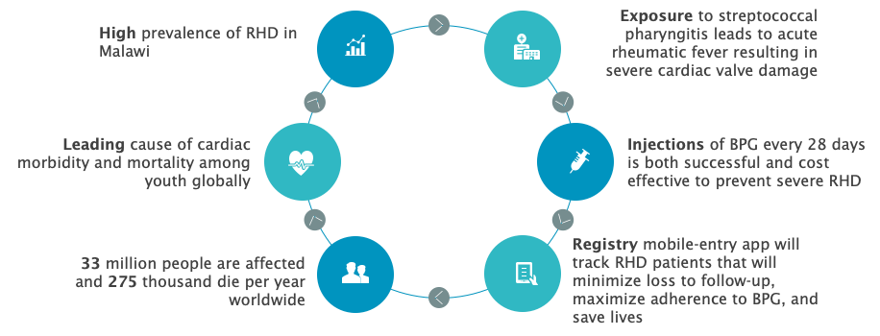
High Prevalence of RHD in Malawi Leads to Cardiac Morbidity and Mortality

Slide 4
RHD is Tied to Socio-economic Inequalities on a Global Scale
World health Organization's Global Resolution on Rheumatic Fever and Rheumatic Heart Disease call for:
“Strengthen data collection and knowledge of RHD prevalence in endemic countries.”
Recommends using “cost effective medicines and technologies for the prevention and control of RHD”, which includes appropriate monitoring and treatment of strep and RHD. ³
Telehealth outreach methods are critical to reach and track those with RHD:
Brazil 2016 Study: screened children in their communities using portable tools. Found higher prevalence rates than previous studies.⁴
Australia: RHD prevalent in children from indigenous communities.⁵
Use of Tracking Apps to monitor RHD occurrences and vaccinations. Treatment Tracker App : https://www.rhdaustralia.org.au/treatment-tracker-app

Slide 5
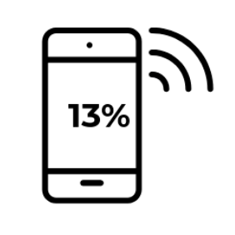
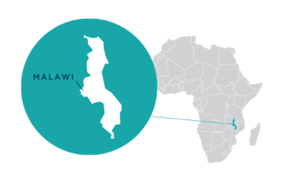
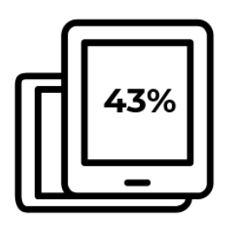
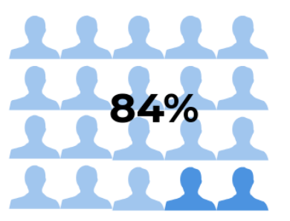
Malawi’s Population Primarily Lives in Rural Areas With Limited Data Access
8.6 million mobile connections⁶
Mobile Band Penetration
Mobile Phone Penetration
Rural Population

Slide 6
A Mobile Solution To Improve RHD Surveillance
Design Challenge: How can local health workers in Malawi keep an accurate, up-to-date record of youth who have RHD and connect them with the appropriate resources to ensure that they do not develop further strep throat or more severe chronic disease?
Goal: Our goal is to improve the surveillance of rheumatic heart disease cases among youth in rural and urban Malawi while also ensuring that registered youth are receiving monthly injections of benzathine penicillin G (BPG) to prevent further strep throat and more severe rheumatic heart disease.
Local health workers refer patients with RHD symptoms to Central Hospital to be diagnosed.
Kamuzu Central Hospital workers enter data relevant to diagnosed patient (name, date of next injection, etc.).
Local health workers have access to data from Central Hospital to determine if patient is overdue for injection.
Health workers reach out to patients in need of another injection. Patients get additional vials from Central Hospital if needed.
Patient data is updated and the next injection date is calculated.

Slide 7
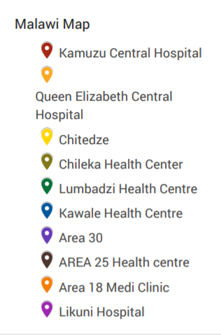
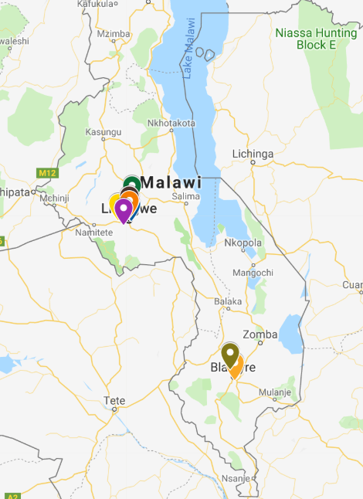
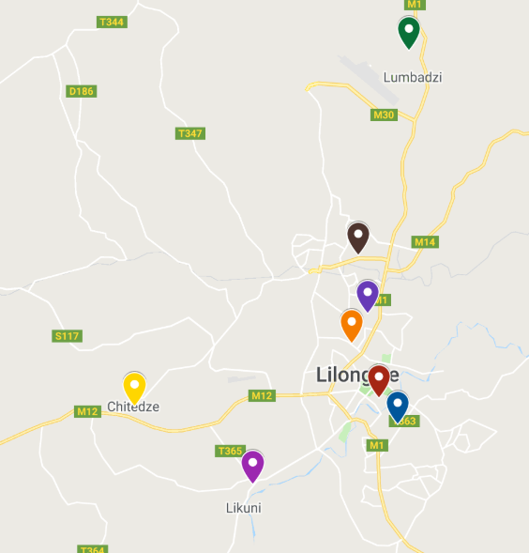
Data Will Be Collected in 2 Central Hospitals & 8 Local Health Centers in Malawi

Slide 8
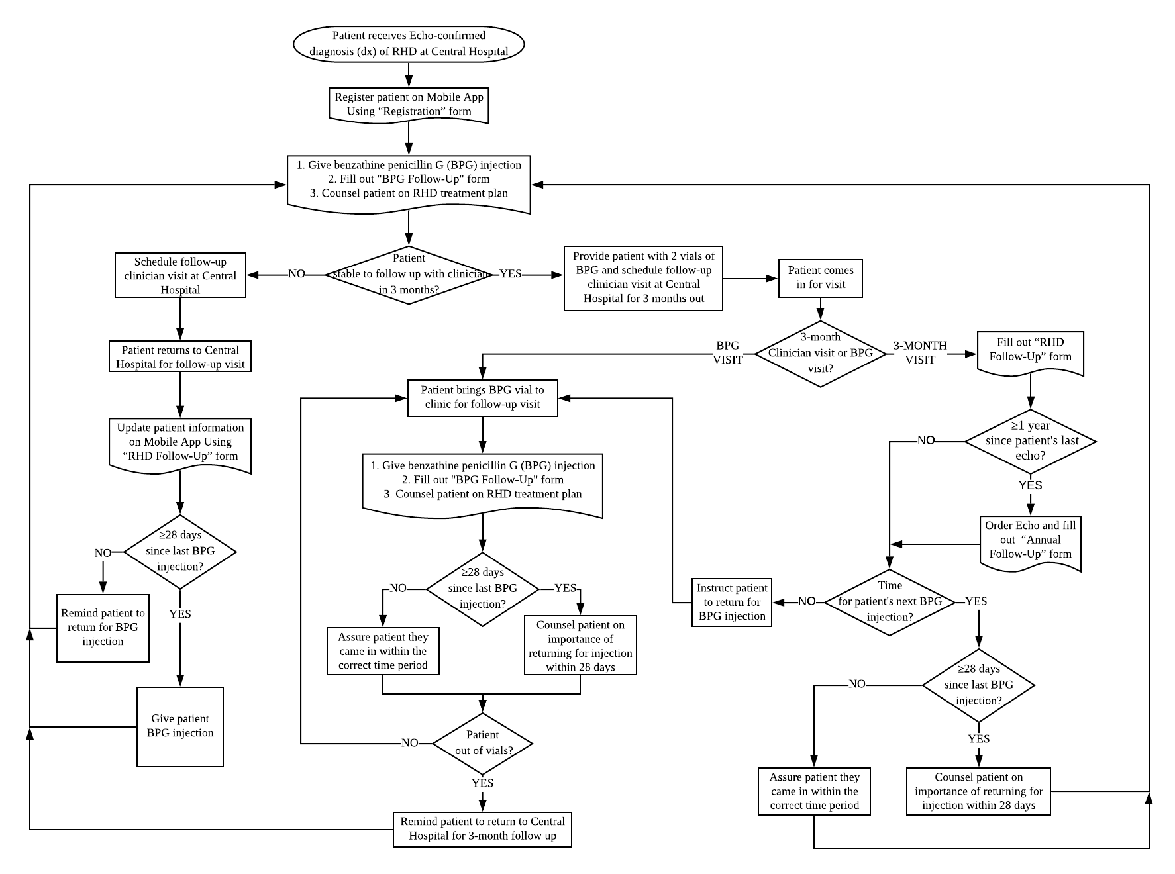
Process Map Visualizing Registration and Treatment of RHD

Slide 9
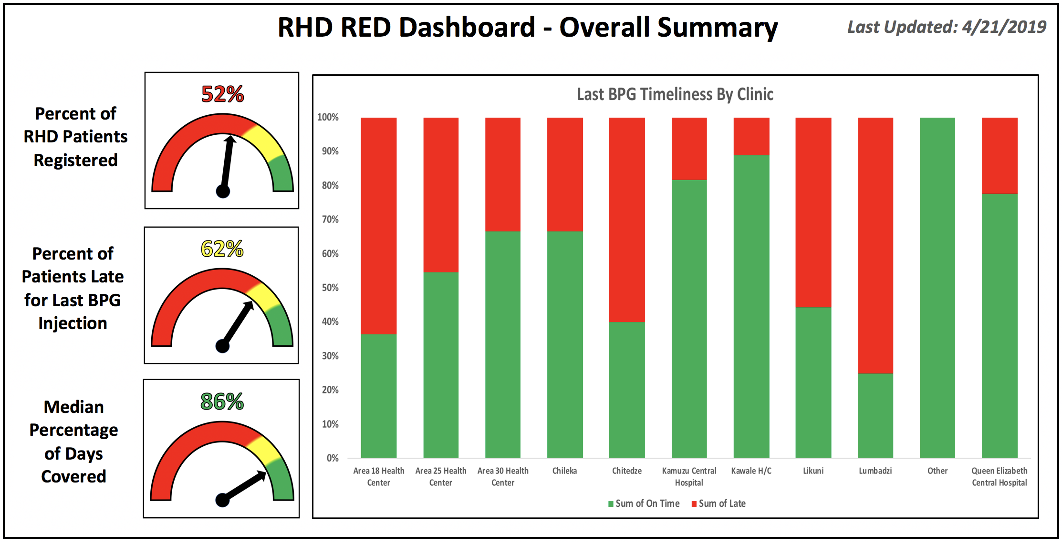
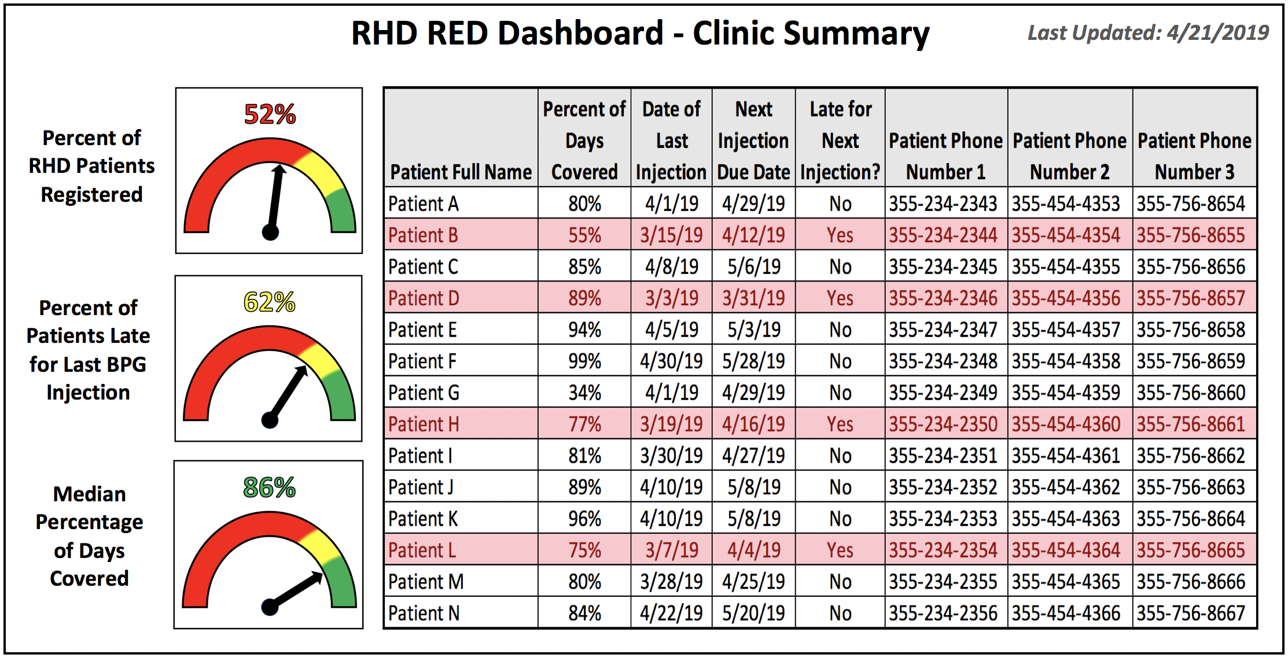
Surveillance of RHD Patient Data Via Dashboard
Metric 1: Percent of patients late for last BPG injection (fuel gauge:0-100%)
Numerator: # patients >= 1 day late for last BPG injection
Denominator: Total # patients registered in app
Metric 2: Metric 1 stratified by clinic location (stacked bar chart: 0-100%; red for % late, green for % on time)
Metric 3: Median percentage of days covered (fuel gauge: 0-100%; >= 80% goal)
Summary of patient-level BPG adherence data
Range and standard deviation
Metric 4: Percent of RHD patients registered on the app (fuel gauge: 0-100%)
Numerator: number of cases on app
Denominator: estimated number of RHD patients in population served

Slide 10
Monitoring and Evaluating Key Components Should Result in Successful Implementation
Satisfaction assessment from local health workers (front-end user)
Frequency of use with patient
Satisfaction assessment from Dr. Sanyahumbi (back-end user)
Frequency of data reporting
Completeness of data collected over time
Data error rate over time
Usefulness of data over time
Time to implement at the clinic
Time of training
Cost analysis: Cost savings from prevented hospitalizations over time compared to costs of program
Usability
Data Quality
Cost

Slide 11
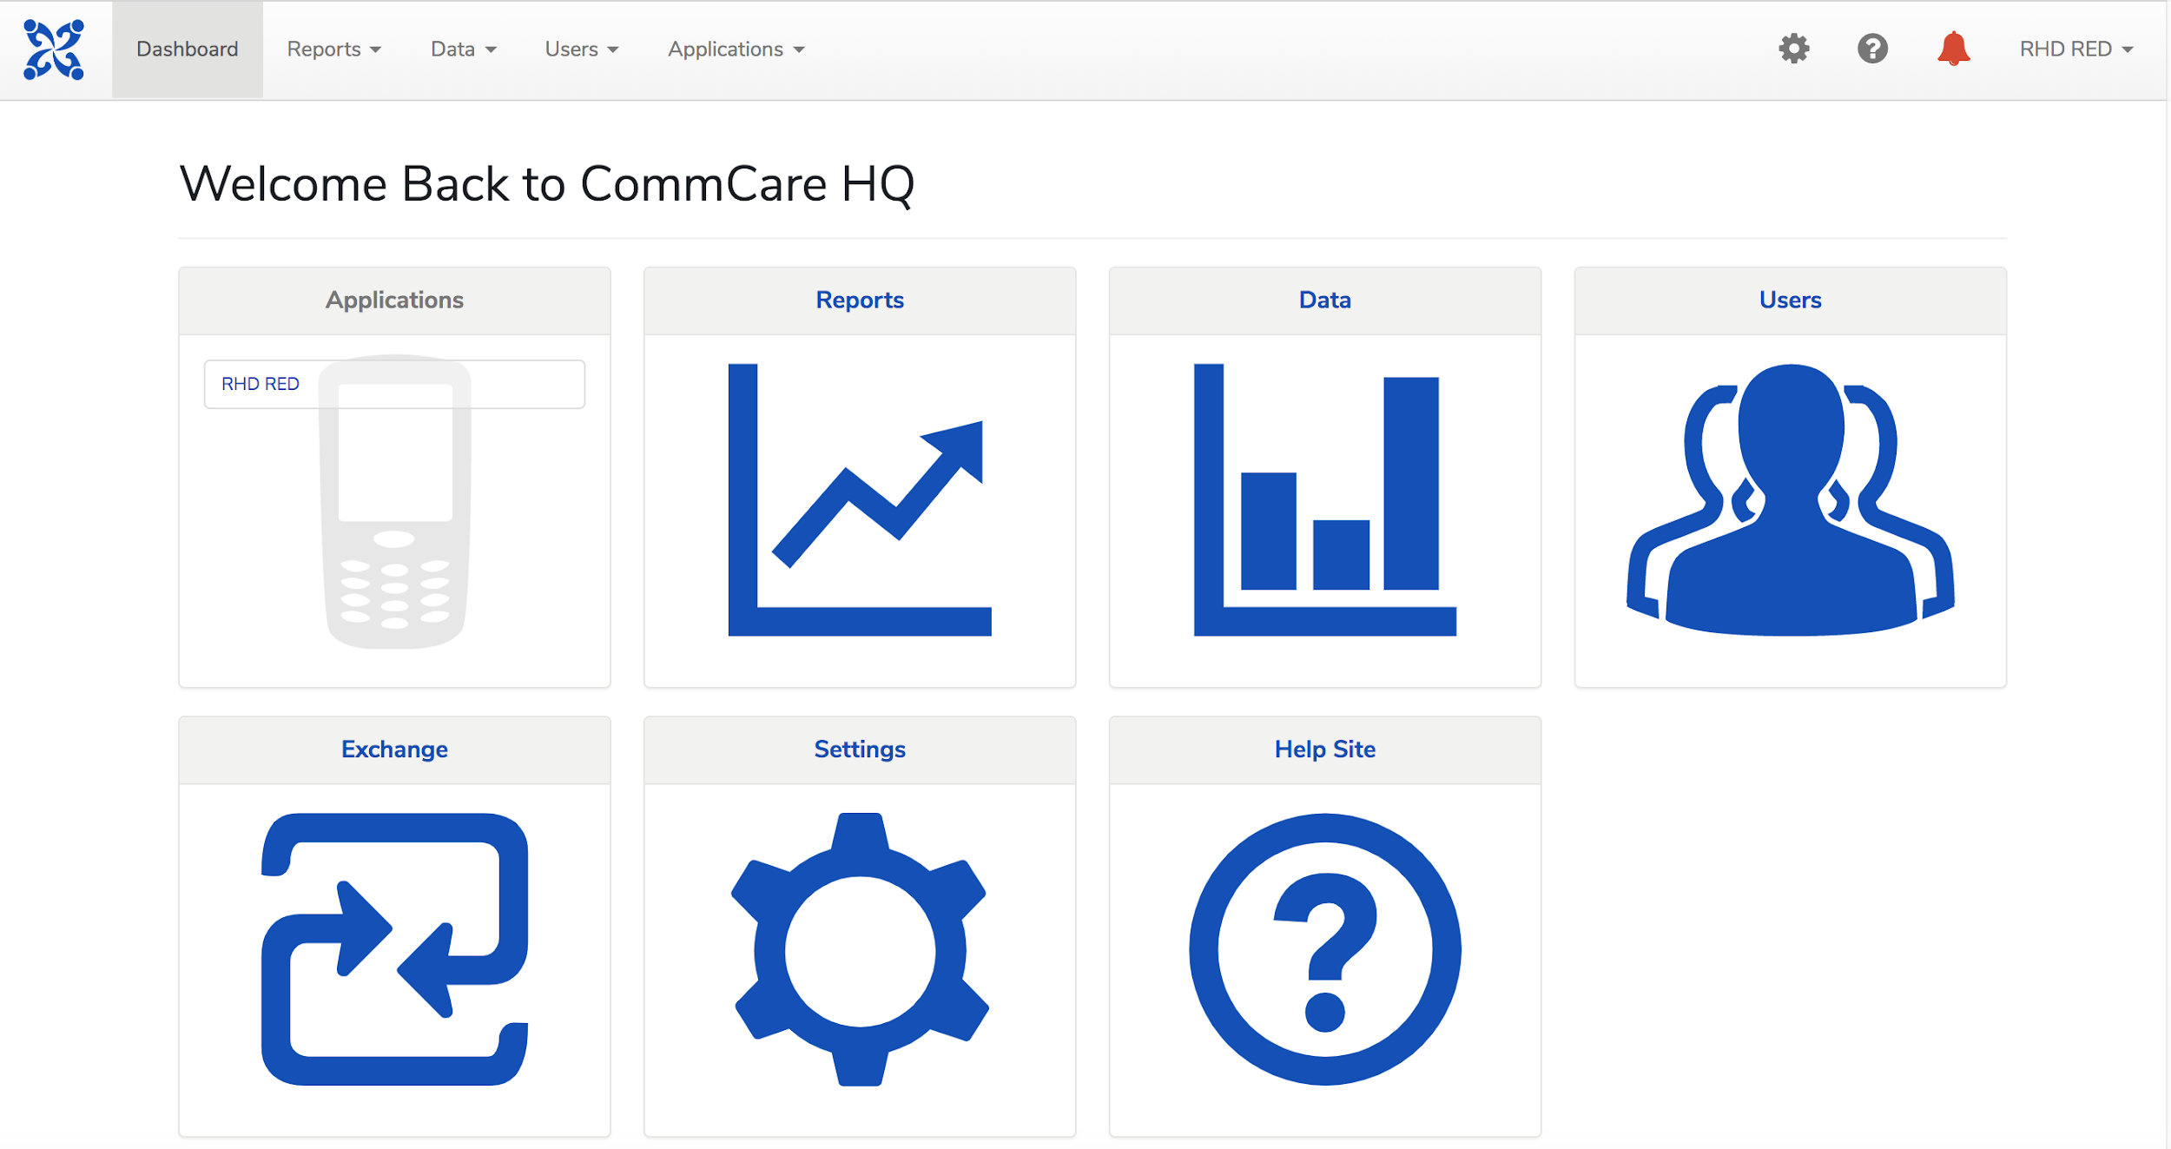
CommCare is an Ideal Platform for the RHD RED Application
Runs as a mobile-based app on 2 types of devices: android smartphones & basic feature phones.
Tracks & supports clients, facilities, transactions, or anything else that needs to be followed over time.
2 Components
CommCare HQ: website used for app management & reporting. Users design app, access data, and manage mobile workers.
CommCare Mobile: mobile-based used for data collection & service delivery (used on phone or tablet).
Useful for data collection, decision support, job aid, counseling tool & better supervision.

Slide 12
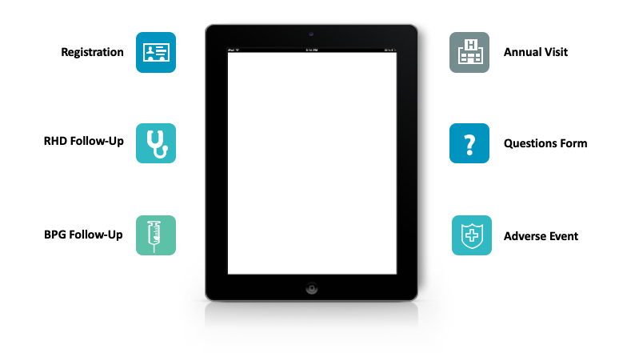
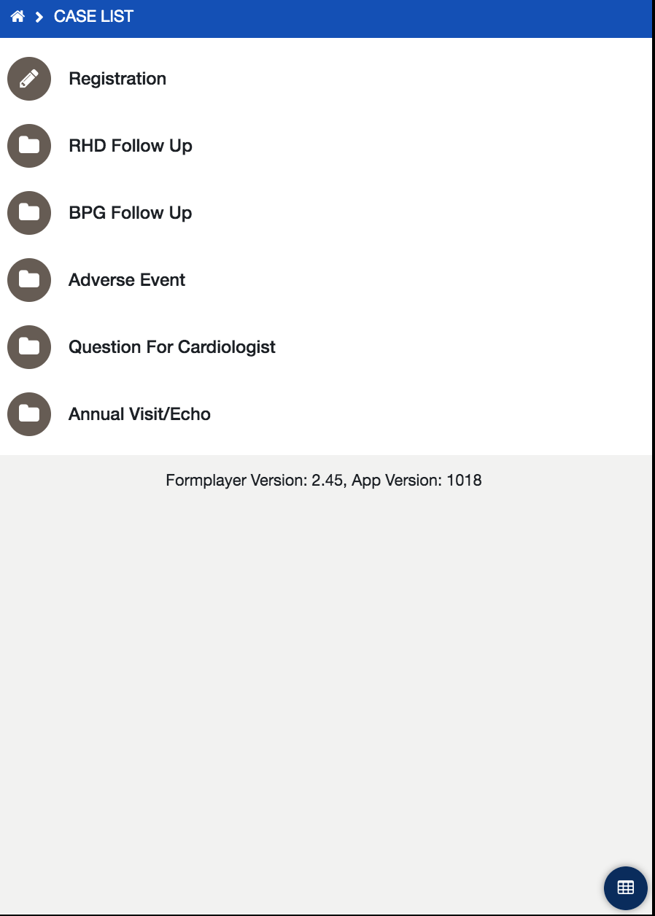
WHO Recommends a Registry to Track RHD Patients
The RHD RED application will contain a total of 6 forms

Slide 13
RHD RED Functions to Register and Follow Patients
Registration
Register RHD patients.
RHD Follow-Up Completed every three months by Dr. Sanyahumbi at the Kamuzu Central Hospital.
BPG Follow-Up Completed by central hospital or at local health centers when patient receives BPG injection.
Adverse Event Form
Completed when an adverse event, transfer of care, or death has occurred.
Questions for Cardiologist
Completed by local health workers when they have questions for Dr. Sanyahumbi. Includes FAQ.
Annual Visit/Echo
Completed during annual check-in. Annual echocardiograms are required.

Slide 14
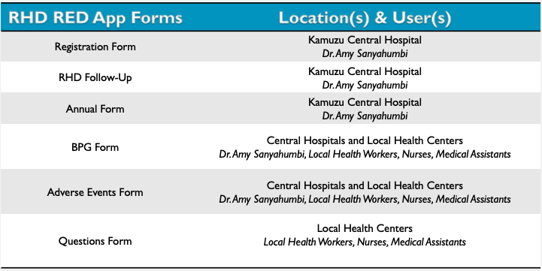
The Location(s) & User(s) of the RHD RED App Depends on the Form Type

Slide 15
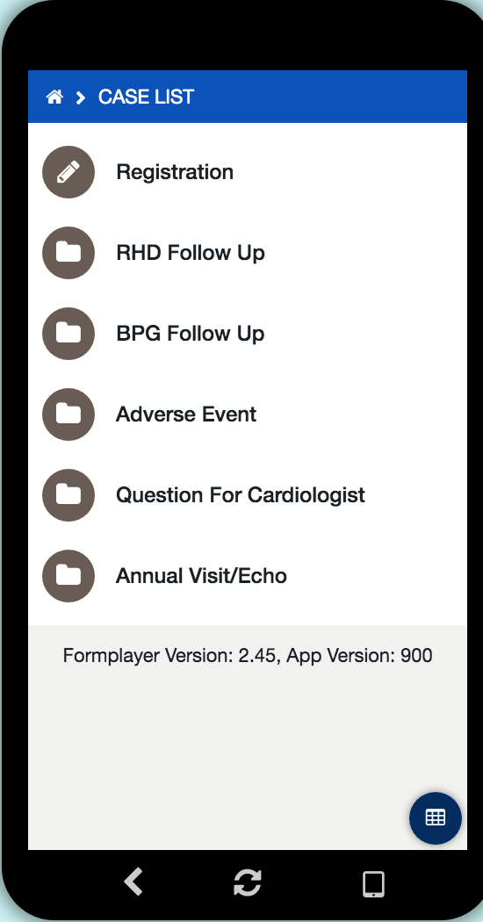
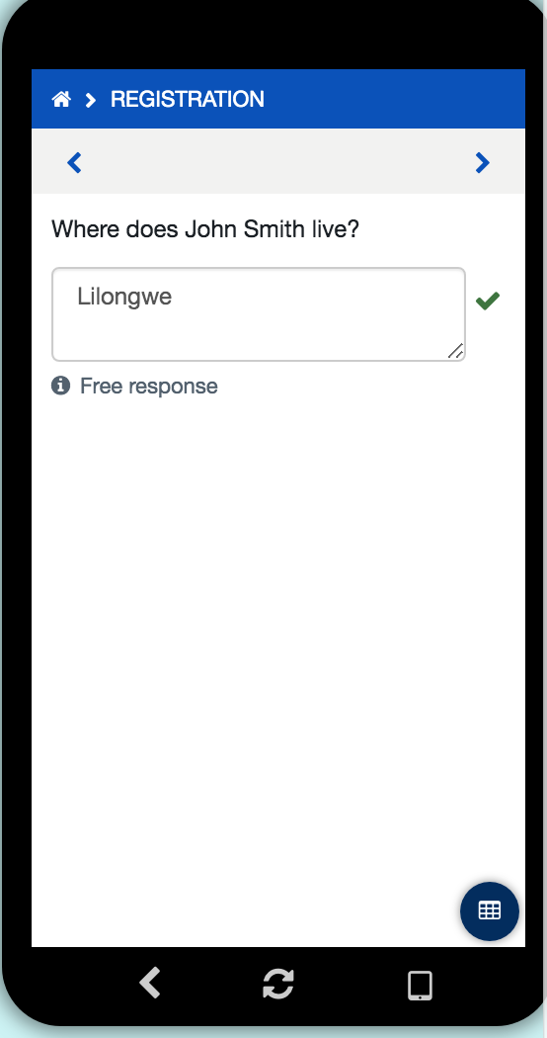
User Guide: Registration Form
Objective: Registration form filled out by pediatric cardiologist, Dr. Amy Sanyahumbi, at the central hospital to input new patients into RHD Registry.
Step 1
To begin, click on Registration form
Step 2
Register patient by inputting first & last name
Step 3
Follow prompt & complete questions in form

Slide 16
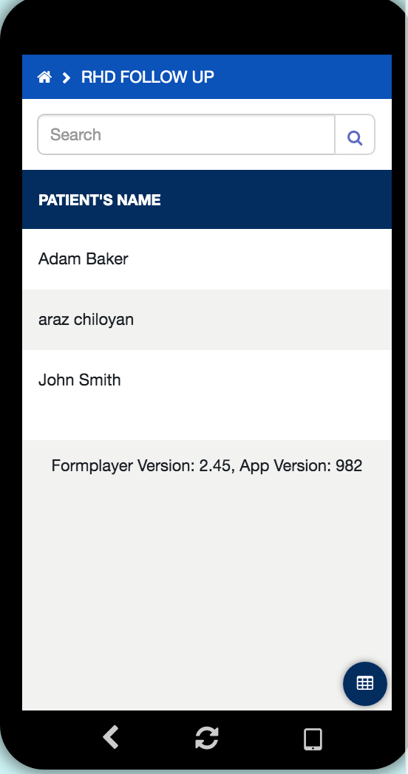
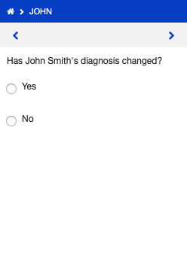
User Guide: RHD Follow-Up Form
Objective: RHD Follow-Up form is filled out by pediatric cardiologist, Dr. Amy Sanyahumbi, at the central hospital to check-up on RHD patient during 3-month visit if patient is stable or earlier than 3 months if patient is unstable.
Step 1
To begin, click on RHD Follow Up form
Step 2
Select patient from case list
Step 3
Follow prompt & complete questions in form

Slide 17
User Guide: BPG Follow-Up Form
Objective: The BPG form is completed by either central hospital staff or the local health workers. This form monitors bpg injections and alerts the health worker if the patient is late for their BPG injection.
Step 1
Go to Case List &
Select BPG Follow Up form
Step 2
Select patient name
Step 3
Follow prompt & complete questions in form

Slide 18
User Guide: Adverse Events Form
Objective: The Adverse Event Form is completed by local health workers if a death, transfer of care, or “other events” with patient has occurred.
Step 1
Go to case list & select Adverse Event form
Step 2
Select patient name
Step 3
Follow prompt & complete Adverse Event form questions

Slide 19
User Guide: Question Form
Objective: The “Question for Cardiologist form” is completed by the local health workers. This form connects the pediatric cardiologist, Dr. Amy Sanyahumbi and the local health worker to communicate any questions or concerns.
Step 1
Go to case list & select Adverse Event form
Step 2
Select patient name
Step 3
Follow prompt & complete Adverse Event form questions

Slide 20
Annual Follow-Up Form
Objective: Annual follow-up form filled out by pediatric cardiologist, Dr. Amy Sanyahumbi, at the central hospital to input new patients into RHD Registry and continue to monitor patient during annual visit throughout patient’s lifetime. Used to keep track of patient’s echocardiogram info.
Step 1
Go to case list & select Annual Visit/Echo form
Step 2
Select patient name
Step 3
Press continue & answer questions accordingly

Slide 21
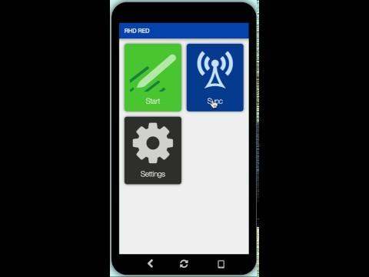
A Video Guide to Using the RHD RED Application

Slide 22
Scale-Up & Sustaining the RHD RED App in Malawi

Slide 23
CommCare Pricing Options for Scale-Up
0
Free
Standard
Pro
Advanced
Basic features
Guaranteed email support within 3 business days
All Standard features
All Pro features
No SMS
Guaranteed email support within one business day
Phone support
Lookup tables
Custom branding
10 Mobile Users
Case importer
Web-based applications
API access
HIPAA compliance assurance
Data management tools
External app integration framework
One-way SMS
125 Mobile Users
Two-way SMS
250 Mobile Users
500 Mobile Users
$0/month
$300/month
$600/month
$1,200/month

Slide 24
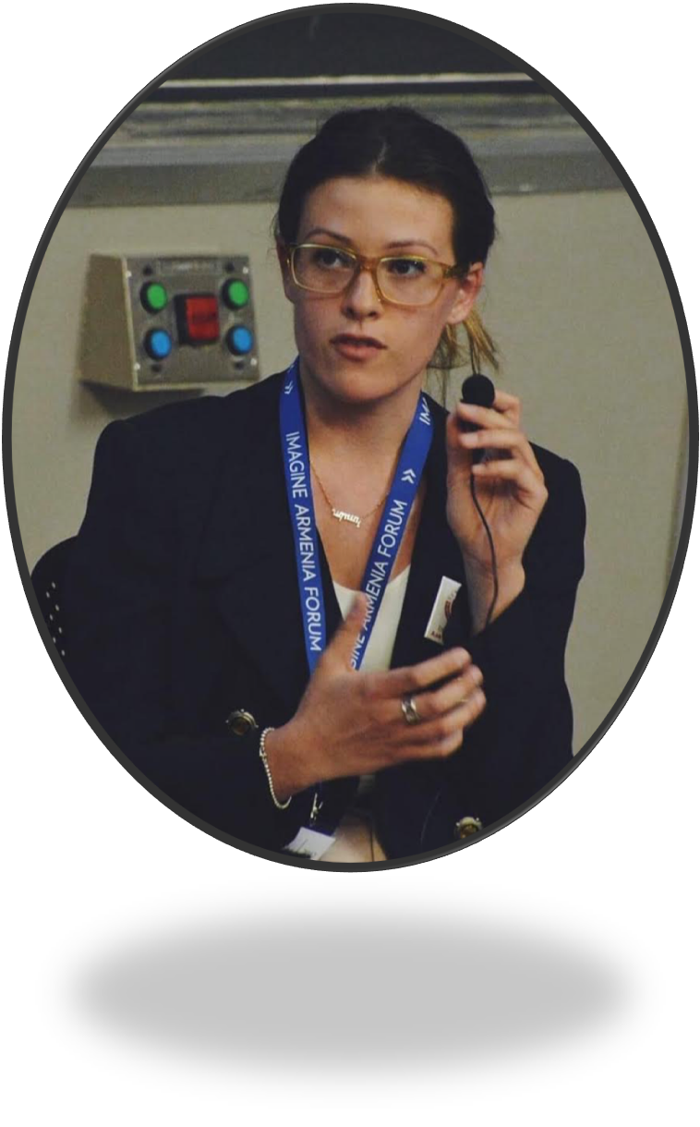
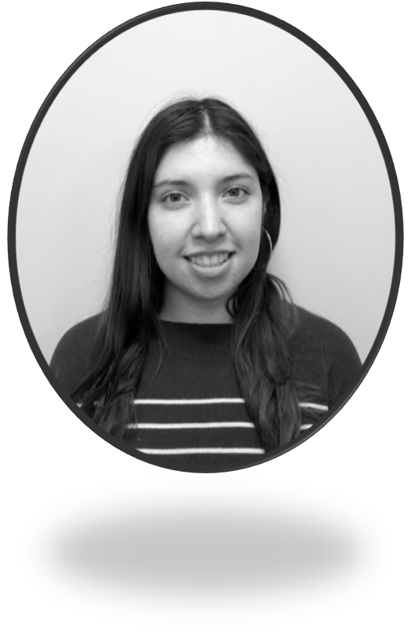
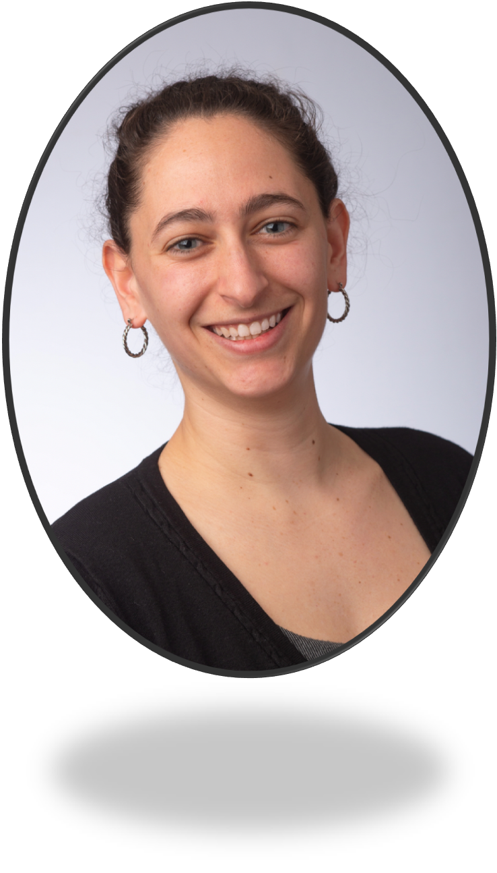
Novus Health Consulting Team
Application Name: RHD RED App
Project Space: https://www.commcarehq.org/a/rhd-red/dashboard/project/
Yara Altaher
yaltaher@bu.edu
Araz Chiloyan
chiloyan@bu.edu
Maria Campos
mgcampos@bu.edu
Jack Zhu
zhuj95@bu.edu
Haley Friedler
hfried@bu.edu

Slide 25
References
Admin. RHD Action Small Grant Update: Malawi. http://rhdaction.org/news/rhd-action-small-grant-update-malawi. Published April 23, 2018. Accessed April 30, 2019.
RHD Resolution_Background Info_RHD Resolution Campaign Pack.pdf. http://rhdaction.org/sites/default/files/RHD%20Resolution_Background%20Info_RHD%20Resolution%20Campaign%20Pack.pdf. Accessed April 30, 2019.
World Heart Federation. (2018, May 25). BREAKING NEWS: Governments Adopt a Global Resolution on Rheumatic Fever and Rheumatic Heart Disease at the World Health Assembly. Retrieved April 9, 2019, from https://www.world-heart-federation.org/news/breaking-news-governments-adopt-global-resolution-rheumatic-fever-rheumatic-heart-disease-world-health-assembly
Nascimento, B. R., Sable, C., Nunes, M. C., Diamantino, A. C., Oliveira, K. K., Oliveira, C. M., . . . Vitória M. L. R. De Rezende. (2018). Comparison Between Different Strategies of Rheumatic Heart Disease Echocardiographic Screening in Brazil: Data From the PROVAR (Rheumatic Valve Disease Screening Program) Study. Journal of the American Heart Association, 7(4). doi:10.1161/jaha.117.008039
Parnaby, M. G., & Carapetis, J. R. (2010). Rheumatic fever in Indigenous Australian children. Journal of Paediatrics and Child Health, 46(9), 527-533. doi:10.1111/j.1440-1754.2010.01841.x
2017 – GSMA Mobile Connectivity Index. 2017 – GSMA Mobile Connectivity Index. https://www.mobileconnectivityindex.com/. Accessed May 6, 2019.
Beyond Our Borders: Global Health in Pediatric Heart Disease – From Africa to Latin America - American College of Cardiology. https://www.acc.org/latest-in-cardiology/articles/2017/08/21/11/08/beyond-our-borders. Accessed May 6, 2019.

